Slide 1

Locating Ourselves in Queens
Who Are Our Students?
Notes:
"Peace Through Understanding”
New York World's Fair of 1964-65
Designed by landscape architect Gilmore D. Clarke (1892–1982)
https://www.nycgovparks.org/parks/flushing-meadows-corona-park/highlights/12761#:~:text=The%20Unisphere%2C%20located%20at%20the,New%20York%20City's%20park%20infrastructure.

Slide 2
Locating Ourselves in Queens
Who Are Our Students?
Most are from Queens (~71%)
 | 2014 | 2024
Queens | 67% | 71%
Nassau | 19% | 13%
Brooklyn | 5% | 6%
Suffolk | 4% | 3%
Bronx | 2% | 3%
Manhattan | 2% | 2%
Other County | 3% | 2%
CUNY IRDB Data

Slide 3
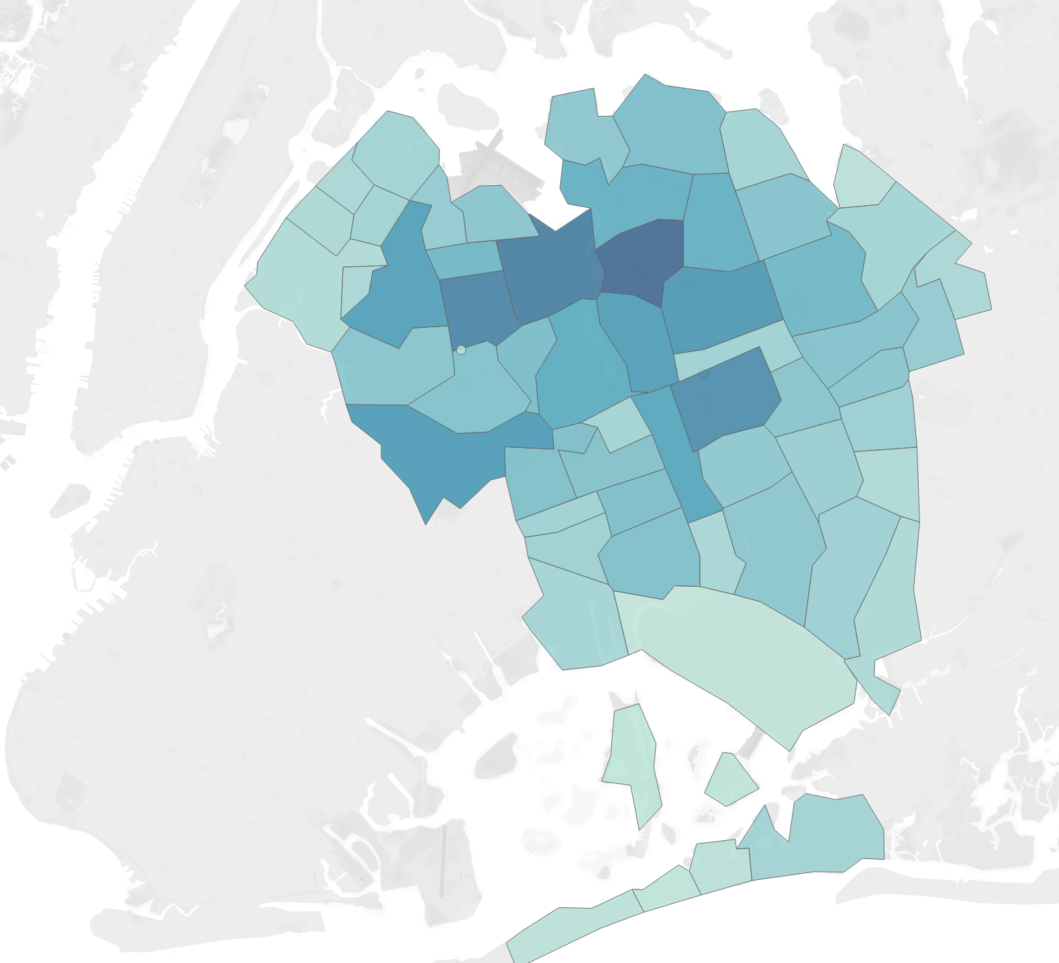
Locating Ourselves in Queens
Who Are Our Students?
Most are from Queens
… ALL OVER Queens
Neighborhood | %
Flushing | 18.0%
Jamaica | 5.1%
Corona | 5.0%
Fresh Meadows | 4.8%
Elmhurst | 4.6%
Queens Village | 4.6%
Jamaica Est | 4.3%
Glendale | 3.4%
Astoria | 3.3%
CUNY IRDB Data

Slide 4
Locating Ourselves in Queens
Who Are Our Students?
Most are from Queens
Many are looking for community

Slide 5
Locating Ourselves in Queens
Who Are Our Students?
Most are from Queens
Many are looking for community
What has been the best part of your experience at QC so far?
Fall 2024 New Student Survey

Slide 6
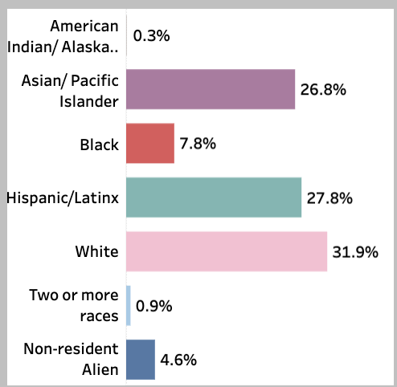
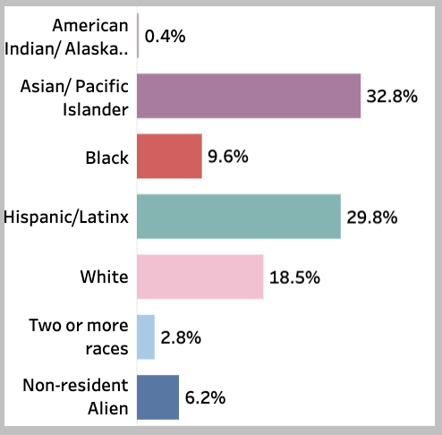
Locating Ourselves in Queens
Who Are Our Students?
Most come from racial/ethnic minority communities (~78%)
2014 | 2024
+0.1%
+6.0%
+1.8%
+2.0%
-13.4%
+1.9%
+1.6%
Queens College Student Profile
Notes:
https://public.tableau.com/app/profile/qc.oie/viz/1_CollegeProfile-EnrolledStudents/EnrolledStdntProfile
The QC GSSP webpage state that 35% of our students are foreign-born.
https://discover.queensgssp.com/about/

Slide 7
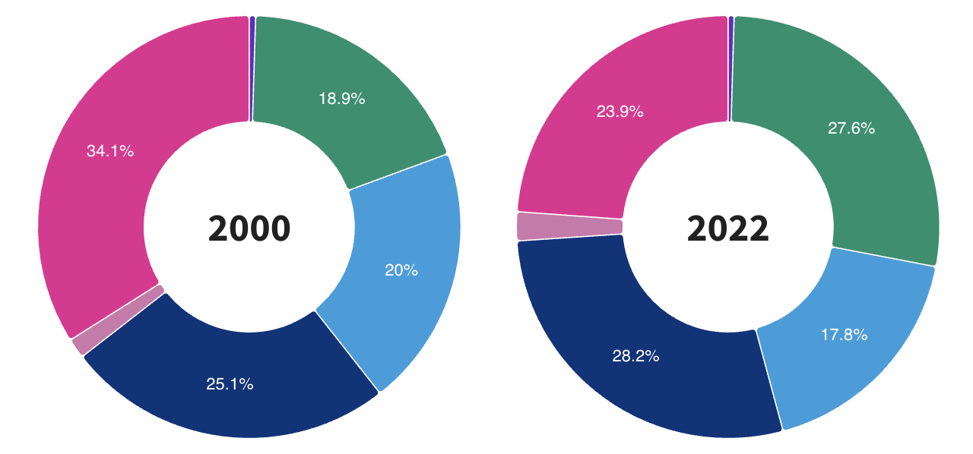
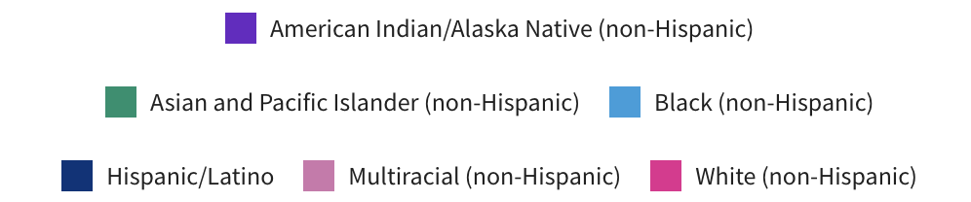
Locating Ourselves in Queens
Who Are Our Students?
Racial / Ethnic Makeup of Queens County Over Time
Between 2000 and 2022
the AAPI population in Queens increased by 8.7 percentage points,
the White population in Queens decreased by 10.2 percentage points.
20%
24%
28%
34%
20%
18%
28%
25%
US Census Data
Notes:
https://usafacts.org/data/topics/people-society/population-and-demographics/our-changing-population/state/new-york/county/queens-county/#:~:text=How%20has%20the%20racial%20and%20ethnic%20makeup,the%20population%20compared%20with%2027.9%%20in%202010.

Slide 8
Locating Ourselves in Queens
Who Are Our Students?
Most are multilingual (~68%)
Grew up speaking
NO ENGLISH
24%
Grew up speaking ENGLISH ONLY
32%
Grew up speaking
ENGLISH PLUS
44%
2022 Academic Writing Survey (W courses), RR = 9%

Slide 9
Locating Ourselves in Queens
Who Are Our Students?
Most identify as religious (~71%)
 | 2002 | 2022
Buddhist | 5% | 2%
Christian (Catholic, Protestant… | 46% | 36%
Hindu | 2% | 6%
Jewish | 15% | 7%
Muslim | 7% | 15%
No Religion | 17% | 29%
Other Religion | 8% | 5%
2002 CUNY SES, RR = 35% / 2022 CUNY SES, RR = 11%
Notes:
2022: https://insights.cuny.edu/t/CUNYGuest/views/2022StudentExperienceSurvey/StudentExperienceSurveySES?%3Aembed=y&%3AisGuestRedirectFromVizportal=y
2002: https://www.cuny.edu/wp-content/uploads/sites/4/page-assets/about/administration/offices/oira/institutional/surveys/SES2002FinalReport.pdf

Slide 10
Locating Ourselves in Queens
Who Are Our Students?
About a quarter identify as LGBTQ+
Unsure
8%
Yes
22%
No
70%
2022 QC DEI, Student RR = 7%
Notes:
https://www.qc.cuny.edu/oie/surveys/

Slide 11
Locating Ourselves in Queens
Who Are Our Students?
Half receive PELL
Queens College Student Profile
Notes:
https://public.tableau.com/app/profile/qc.oie/viz/1_CollegeProfile-EnrolledStudents/EnrolledStdntProfile

Slide 12
Locating Ourselves in Queens
Who Are Our Students?
Half receive PELL
  The national average is 34%
Queens College Student Profile
Notes:
https://educationdata.org/pell-grant-statistics

Slide 13
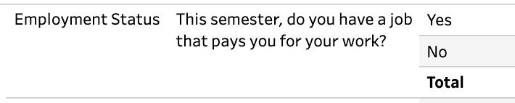
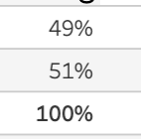
Locating Ourselves in Queens
Who Are Our Students?
Half receive PELL
  The national average is 34%
Half work for pay
2022 CUNY Student Experience Survey
Queens College Student Profile
Notes:
https://insights.cuny.edu/t/CUNYGuest/views/2022StudentExperienceSurvey/StudentExperienceSurveySES?%3Aembed=y&%3AisGuestRedirectFromVizportal=y

Slide 14
Locating Ourselves in Queens
Who Are Our Students?
Queens College is an engine for upward social and economic mobility.
We are in the top 1% of U.S. colleges that help students from the bottom 20% of the income distribution reach the top 20% in earnings.
Chronicle of Higher Education 2018 / Chetty et al. 2017, Mobility Report Cards
Notes:
https://www1.cuny.edu/mu/forum/2018/08/24/the-chronicle-of-higher-ed-ranks-queens-college-in-top-1-of-all-u-s-colleges-for-upward-social-and-economic-mobility/

Slide 15

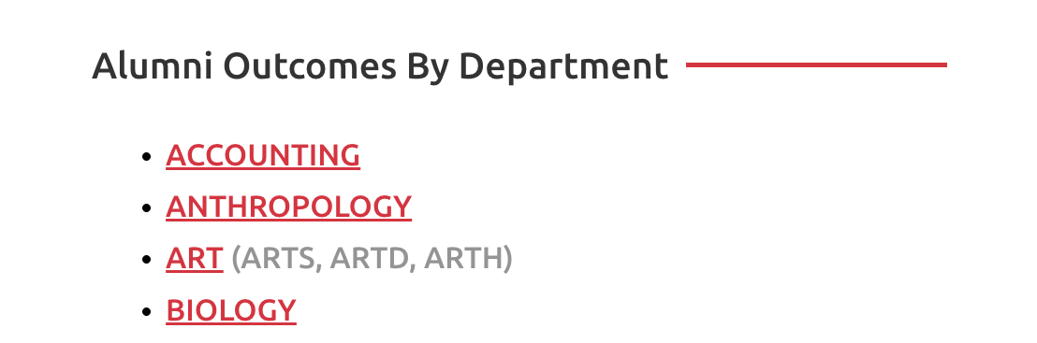
Locating Ourselves in Queens
Who Are Our Students?
Queens College is an engine for upward social and economic mobility.
qc.cuny.edu/oie/alumni-outcomes
Notes:
https://www.qc.cuny.edu/oie/alumni-outcomes/

Slide 16
Locating Ourselves in Queens
Who Are Our Students?
Most are Gen Z (89% are 28 or younger)
Notes:
https://www.washingtonpost.com/technology/2024/04/10/gen-z-feedback-work/
digital‑native; expect flexibility, mental health, transparency

Slide 17
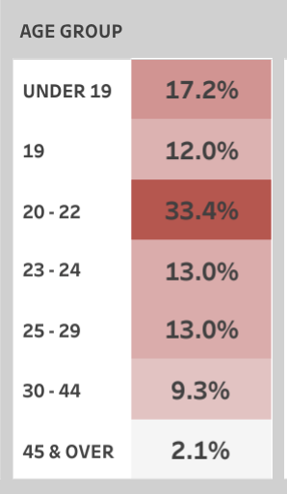
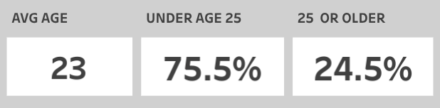
Locating Ourselves in Queens
Who Are Our Students?
Most are Gen Z (89% are 28 or younger)
Fall 2024 Student Profile of Undergraduates
Notes:
https://www.washingtonpost.com/technology/2024/04/10/gen-z-feedback-work/
digital‑native; expect flexibility, mental health, transparency

Slide 18

Locating Ourselves in Queens
Who Are Our Students?
Most are Gen Z
Notes:
https://www.washingtonpost.com/technology/2024/04/10/gen-z-feedback-work/

Slide 19
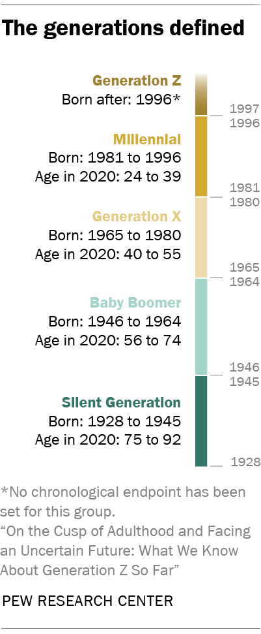
Locating Ourselves in Queens
Who Are Our Students?
Most are Gen Z
  Digital Natives
  Experienced the Pandemic during formative years
  Expect flexibility and transparency
  Have a focus on mental wellness
  More pragmatic than previous generations
Notes:
https://www.washingtonpost.com/technology/2024/04/10/gen-z-feedback-work/

Slide 20
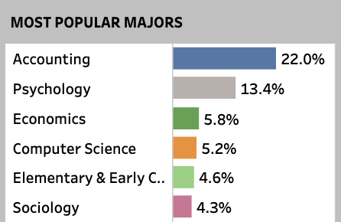
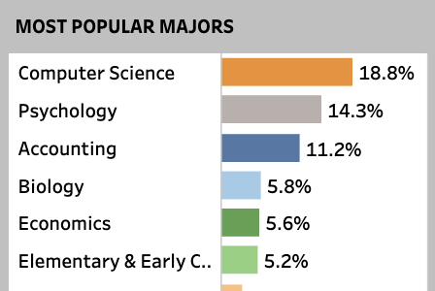
Locating Ourselves in Queens
Who Are Our Students?
Most are Gen Z
Over half pursue degrees in STEM, BUS, or EDUC
Fall 2014 | Fall 2024
Queens College Student Profile
Notes:
https://public.tableau.com/app/profile/qc.oie/viz/1_CollegeProfile-EnrolledStudents/EnrolledStdntProfile

Slide 21
Locating Ourselves in Queens
Who Are Our Students?
Spring 2025 Student Wellness Survey
Strong commitment to their academic and career goals.
Feeling supported determines whether students thrive or struggle.
 | Feels Well- Supported | Not Well- Supported
Feels confident in abilities as a student | 69% | 33%
Can communicate needs to instructors | 56% | 20%
Frequent mental health concerns this term | 21% | 61%
Notes:
https://www.washingtonpost.com/technology/2024/04/10/gen-z-feedback-work/

Slide 22
Locating Ourselves in Queens
Who Are Our Students?
Spring 2025 Student Wellness Survey
How can QC better support students during high-stress periods?
Notes:
https://www.washingtonpost.com/technology/2024/04/10/gen-z-feedback-work/

Slide 23
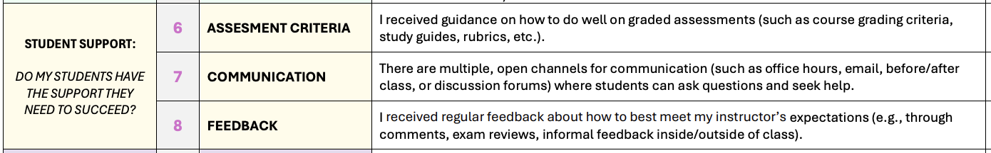
Locating Ourselves in Queens
Who Are Our Students?
The new 2025 Course Evaluation Survey includes items on
transparency, communication, and feedback.
Learn more at qc.cuny.edu/oie/course-evals/
Notes:
https://www.washingtonpost.com/technology/2024/04/10/gen-z-feedback-work/

Slide 24
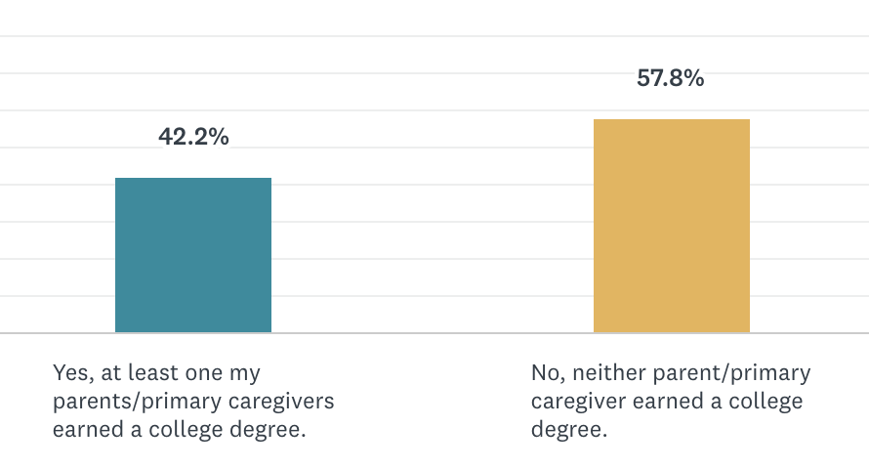
Locating Ourselves in Queens
Over half are among the first in their families to attend college
2022 QC DEI, Student RR = 7%
Notes:
https://tv.cuny.edu/show/cunytvspecial/PR2006057
Chetty, R., Friedman, J. N., Saez, E., Turner, N., & Yagan, D. (2017). Mobility report cards: The role of colleges in intergenerational mobility (NBER Working Paper No. 23618). National Bureau of Economic Research. https://doi.org/10.3386/w23618
https://www.nber.org/system/files/working_papers/w23618/w23618.pdf

Slide 25





Locating Ourselves in Queens
Queens College is a LIBERAL ARTS institution.
  Founded in 1937 as “The People’s College”, we guide our students in exploring ideas new and old across the disciplines, and in gaining perspectives and knowledge that broaden our view of the world and train the mind to think critically, creatively, and independently.
qc.cuny.edu/academics/gened/about/
Notes:
https://tv.cuny.edu/show/cunytvspecial/PR2006057
Chetty, R., Friedman, J. N., Saez, E., Turner, N., & Yagan, D. (2017). Mobility report cards: The role of colleges in intergenerational mobility (NBER Working Paper No. 23618). National Bureau of Economic Research. https://doi.org/10.3386/w23618
https://www.nber.org/system/files/working_papers/w23618/w23618.pdf

Slide 26
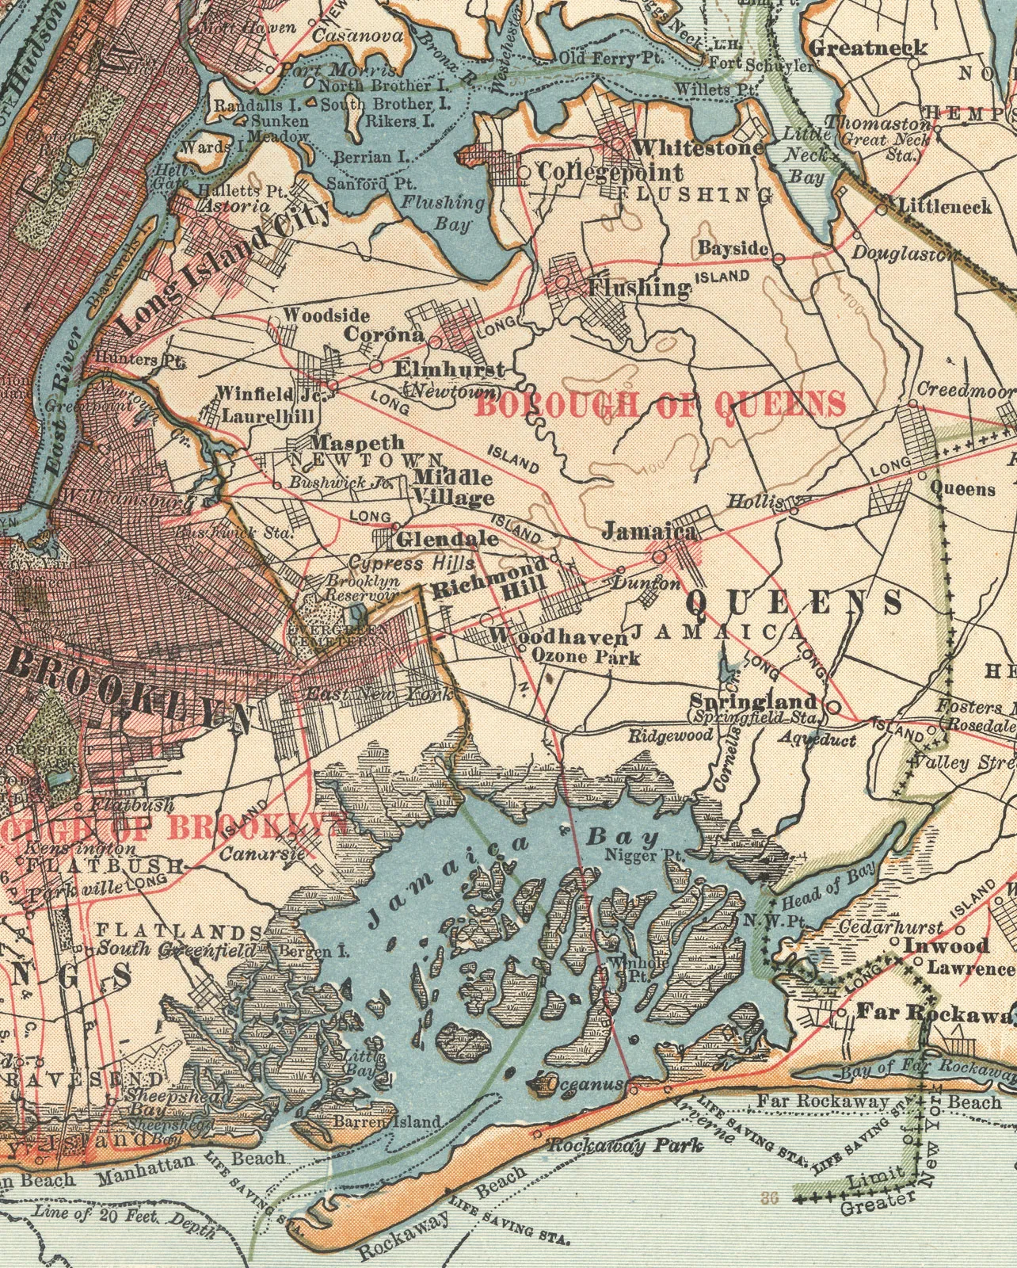
Pedagogy Pop-up Discussion Questions (10/6/25)
What are your general reflections on this data?
  How does this data compare to your own understanding of QC students?
  What surprised you?
  What feels particularly useful to know?
Many of our students are looking for community– making new friends and their professors are named as two of the best parts of their QC experience.
  Are there ways that your teaching practices support (or could support) community-building?
  Does this presentation bring up new questions or ideas?
Transparency around assessments , communication, and feedback are three areas through which faculty support students to succeed.
  What methods do you use to offer these supports?
  Does this presentation bring up new questions or ideas?

Slide 27
Data in this presentation include:
QC OIE Dashboards QC Student Profile
QC OIE Surveys https://www.qc.cuny.edu/oie/surveys/
2002 CUNY SES 2002 CUNY Student Experience Survey
2022 CUNY SES 2022 CUNY Student Experience Survey
QC Alumni Outcomes Project https://www.qc.cuny.edu/oie/alumni-outcomes/
Pew Research Center
    Where Millennials end and Generation Z begins
    What We Know About Gen Z So Far
    37% of U.S. H.S. students report mental health struggles
QC Course Evaluations Faculty Resources for Course Evaluations
Chetty et al. 2017 Mobility Report Cards

