Slide 1
AI Policy and Classroom Conversations
Dr. S.E. Hackney - GSLIS - November 14, 2025

Slide 2
Syllabus Statement:
I, as your professor, do not and will not make use of AI tools to conduct any part of this class. I do not use AI tools to read or grade your papers, or to assess them for plagiarism. I do the reading, and prepare my feedback myself, and I never, ever, expose student work to potential AI content farming. The environmental and resource costs of using AI are overwhelming and destructive; it reproduces and exacerbates structural inequalities, sexism, and racism; and lines the pockets of the already-bloated billionaire class.
It is my strong preference that you do not use AI as a part of your assignments for this class.
You may not use AI to write your assignments outright, nor as a primary research tool. However, I am not banning it altogether. All I ask is that if you made use of an AI tool in the course of preparing for this class or its assignments, please let me know. Tell me what you did, what AI(s) you used, and for what purpose. If I have some question about the authorship of your work, or the way that AI was used to produce it, I will ask you about it, and we will discuss together how best to assess your work and go forward.

Slide 3
Classroom Expectations
I will not ask you to use AI tools as a part of this class
AI is not a secret or taboo
  AI is a topic of conversation and study for our field
Our perspectives will differ, we treat one another with respect and care, and assume good faith
Your assignments should reflect your ideas, thoughts, and opinions
  I am far less concerned with the style or “professionalism” of your work than with your ideas
If you use AI as a part of your research and/or writing, please tell me!

Slide 4
Professional Applications
AI tools are being deployed in the library
Our patrons are using AI tools
What is our role in navigating the AI landscape?
Areas of discussion for our field:
Copyright/Intellectual Property
Mis/disinformation
Information privitization
Top-down AI mandates

Slide 5
Areas of Interest /Concern
Environmental effects
Access gap
Intellectual property
Content milling
Bigotry
Hallucinations, False information
Black Box
Brainrot
Labor

Slide 6
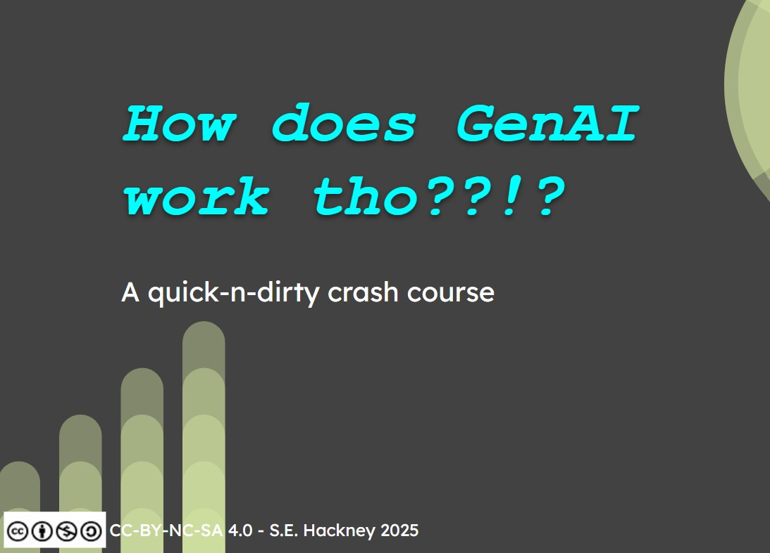
In the works:

