Slide 1
ANTH 3420 Urban Archaeology
Prof. Kelly M Britt
Room 538 IA

Slide 2
Announcements
OER/CUNY Commons Questions?
Office hours-this week Nolcie (after class); next week-no one.
Discussants-Blessing and Jaeden. Next week no one.
Next Week 9/26 at NYP/logistics.
10/3-instead of discussant-lecture by Jaskrian Dhillon, indigenous scholar from New School, talk on Indigenous Resistance, Planetary Dystopia, and the Politics of Environmental Justice. Reading Reflection will be on this lecture not readings. Due AFTER class-by Friday 10/4 at midnight.
Only class that week. Chris rescheduled Discussion section.
Abstracts for your paper due 10/17/19. We will go over what is due the week before.
10/29-Field trip to either Weeksville Heritage Center or Stonewall Inn. Discussants 10/31.

Slide 3
Agenda
Finish film My Brooklyn
Blessing and Jaeden present on readings
Discuss gentrification, urban planning and the role of historic preservation in urban spaces
Exploring Digital Humanities Projects and picking themes-see website. Pick a theme/group.

Slide 4
Kelly Anderson, Director
My Brooklyn (2013)
“Kelly Anderson is a Brooklyn-based documentary filmmaker and educator. Her most recent film is the short documentary Unstuck: an OCD kids movie, which premiered at the 2018 ReelAbilities Film Festival in New York City and screened at the Ashland Independent Film Festival. Her other work includes My Brooklyn, a documentary about gentrification and the redevelopment of Downtown Brooklyn that won an Audience Award at the Brooklyn Film Festival and was broadcast on the PBS World series America ReFramed. She also made Every Mother's Son (with Tami Gold), a documentary about mothers whose children were killed by police officers and who have become national spokespeople for police reform. Every Mother's Son won the Audience Award at the Tribeca Film Festival, aired on POV, and was nominated for a national Emmy for Directing. Kelly's other documentaries include Out At Work (with Tami Gold), which screened at the Sundance Film Festival, was broadcast on HBO and won a GLAAD Award for Best Documentary. She is the author (with Martin Lucas) of Documentary Voice & Vision: a creative approach to non-fiction media production (Focal Press, 2016). A recipient of the George C. Stoney Award for Outstanding Documentary from the University Film and Video Association, Kelly has received funding and fellowships from ITVS, The Rockefeller Foundation and the New York State Council on the Arts. Kelly is a Professor at Hunter College (CUNY) in New York City, where she is Chair of the Department of Film and Media Studies and teaches in the Integrated Media Arts (IMA) MFA program.” (from IMDB)
Has taught at Hunter College, CUNY

Slide 5
My Brooklyn (2013)
https://brooklyn.kanopystreaming.com/video/my-brooklyn

Slide 6
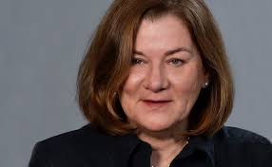
Kathryn M. Kuranda
M.Arch.Hist. – Senior Vice President, Architectural and Historical Services Division for R. Christopher Goodwin and Associates (a CRM firm in 4 locations across country).
From Goodwin’s website: “A court-qualified architectural historian with 35 years of industry experience, 27 of them with the Goodwin team, Ms. Kuranda established and directs the firm’s Architectural and Historical Services Division. Ms. Kuranda holds degrees in American Studies from Dickinson College (B.A.) and in Architectural History from the University of Virginia (M. Arch. Hist.), where she was a Thomas Jefferson Fellow. Over the course of her career, she has directed hundreds of architectural and historical investigations throughout the United States and has served as Principal Investigator for such major studies as National Historic Context for Department of Defense Installations, 1790 – 1940; Housing an Army: The Wherry and Capehart Era Solutions to the Postwar Family Housing Shortage (1949-1962); and the Historic Context for the Army Materiel Command’s World War II Facilities.” http://www.rcgoodwin.com/architectural-history-history/the-goodwin-team-3/
Only woman on the company’s Board of Directors: http://www.rcgoodwin.com/company/officers-board-of-directors/

Slide 7
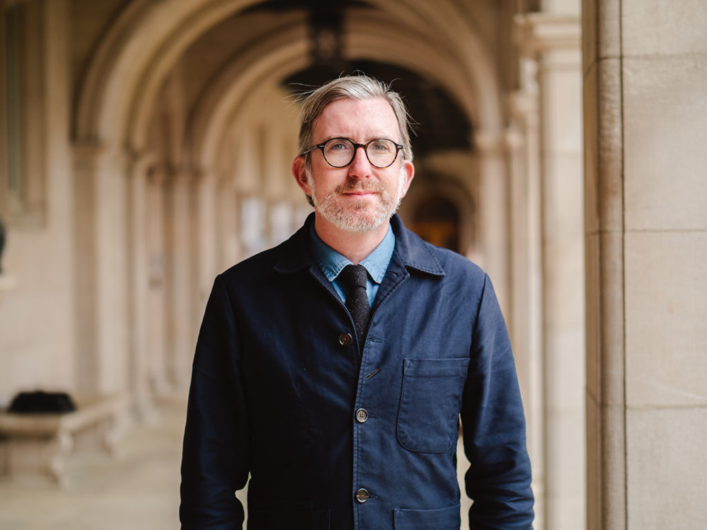
Michael Allen
He “works as an academic researcher, historian, teacher, design critic, public artist, critical spatial tour guide, and heritage conservationist in private practice. Currently, he is a Senior Lecturer in Architecture, Landscape Architecture and Urban Design at the Sam Fox School of Design and Visual Arts, as well as a Lecturer in American Cultural Studies (AMCS), at Washington University in St. Louis, where he served as Coordinator of the AMCS Master of Arts degree from 2014-2018.”
Beginning in fall 2019, he will be pursuing a Ph.D. in Cultural Heritage at the University of Birmingham. He holds a B.A. in English and History from The Union Institute.
From his website:http://www.michael-allen.org/about/

Slide 8
Group Themes
Social
Economic
Political
Ritual
Group 1: James, Jaeden and Blessing
Group 2: Isabel, Angela, Kellen
Group 3: Nolcie, Denille, Chris
Group 4: Jared, Paula, Andrew, Matthew

Slide 9
Questions and Comments
Dr. Kelly M Britt
Kellym.britt@Brooklyn.cuny.edu

