Slide 1
ANTH 3420 Urban Archaeology
Prof. Kelly M Britt
Room 538 IA

Slide 2
Agenda
OER/CUNY Commons Questions?
Office hours-Jaeden this week, next week Nolcie (after class)
Discussants-this week Chris and James, next week Blessing and Jaeden
Next Week 9/26 at NYP/logistics.
10/3-instead of discussant-lecture by Jaskrian Dhillon, indigenous scholar from New School, talk on Indigenous Resistance, Planetary Dystopia, and the Politics of Environmental Justice. Only class that week. Chris rescheduled Discussion section.
10/29-Field trip to either Weeksville Heritage Center or Stonewall Inn. Discussants 10/31.
Exploring Digital Humanities Projects and picking themes-see website.

Slide 3
Urban Archaeology
Architecture and Urban Plans as Technologies of Control

Slide 4
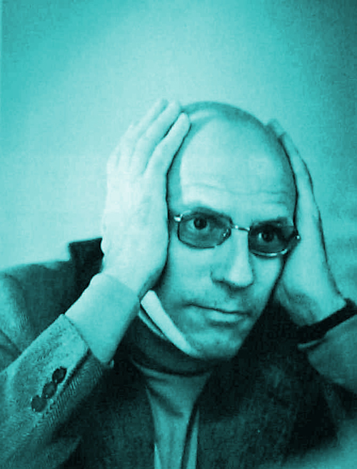
Michel Foucault
French philosopher, social theorist (1926-1984)
  First public figure in France to die of HIV/AIDS
Theoretical focus of the relationship between power and knowledge
Labeled as a post-strucurtalist, post-modernist (though he rejected these labels)
Theories influences many fields including anthropology, sociology, communication studies, cultural studies, literary theory, feminism and critical theory
Major works include:
  The History of Madness (1961)
  The Birth of a Clinic (1963)
  The Order of Things (1966)
  The Archaeology of Knowledge (1969)
  Discipline and Punish (1975)
  The History of Sexuality (1976)

Slide 5
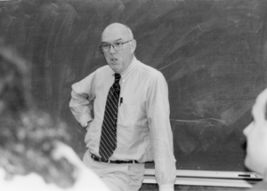
Mark Leone
  1963 BA Tufts University, History
  1966, MA University of Arizona, Anthropology
  1968 PhD, University of Arizona, Anthropology
  1990-present: Professor, University of Maryland, Anthropology Department
  Research Interests:
    Historical archaeology and interpretation, critical theory, African-American archaeology

Slide 6
Definitions
Structuralism-aspects of human culture are understood by their relationship to a broader overarching system or structure. Many concepts revolve around the idea of binary opposition-i.e. signified/signifier, emotional/rational, etc.
Post-Structuralism-offers different critiques of structuralism with a common theme of the rejection of the self-sufficiency of structuralism. Rejects the binary opposition view. “A post-structuralist approach argues that to understand an object (e.g., a text), it is necessary to study both the object itself and the systems of knowledge that produced the object.” Wikipedia-Raulet, Gerard.

Slide 7
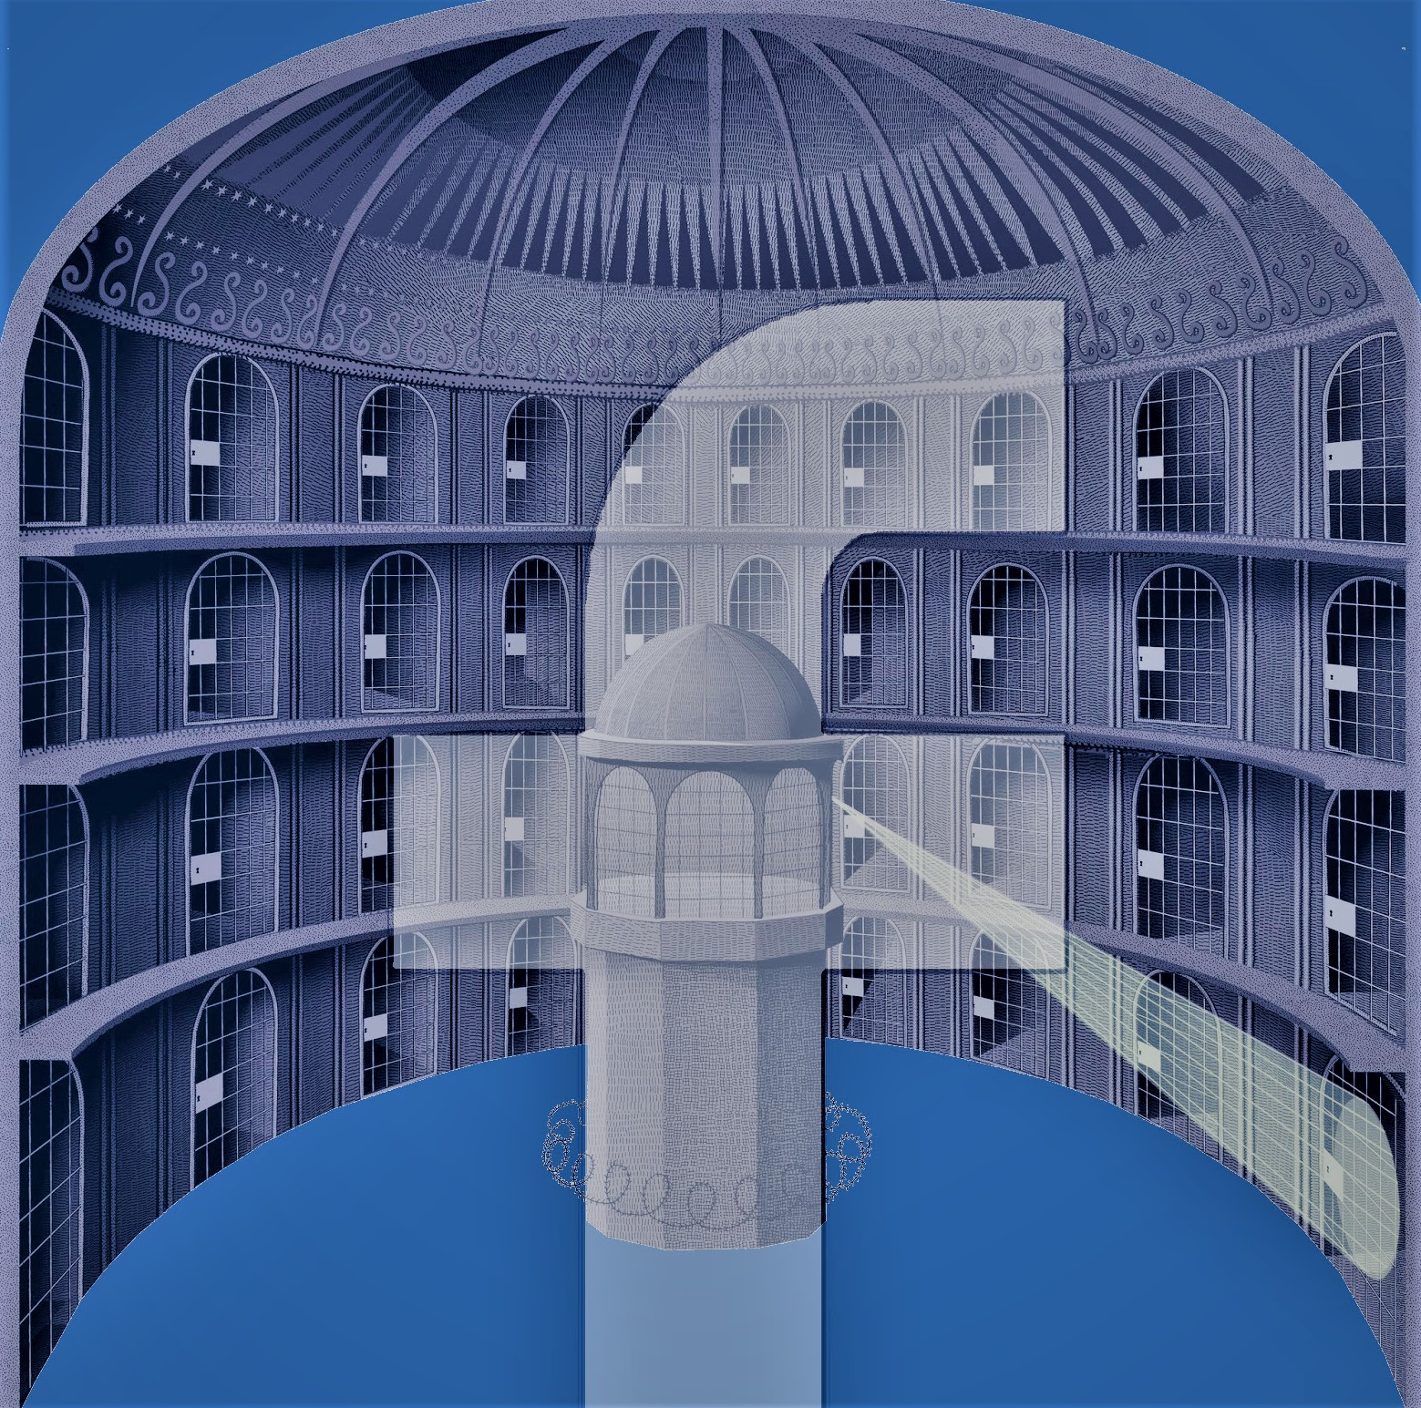
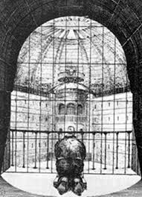
Panopticon-
Jeremy Bentham 18th century

Slide 8
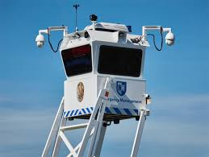
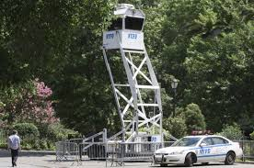
NYC Police “Skywatch"

Slide 9
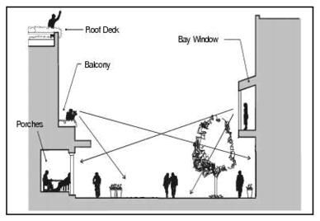
Jane Jacobs- “Eyes on the Street”

Slide 10
Digital Humanities Projects
Some examples:
Hypercities: http://www.hypercities.com/
The Welikia Project: https://welikia.org/
Spatial History Project: http://web.stanford.edu/group/spatialhistory/cgi-bin/site/index.php
Visualizing Emancipation: http://dsl.richmond.edu/emancipation/
The Spread of American Slavery: https://lincolnmullen.com/projects/slavery/

Slide 11
Themes
4 groups of 3
Potential Themes based on Smith’s work
  Social
  Ritual
  Political
  Economic
Do we want to look at these 4 themes, or focus on just one?
Name of project?
  My thought-Mapping the Making of the Urban Landscape: Making Place in Bed Stuy

Slide 12
Questions and Comments
Dr. Kelly M Britt
Kellym.britt@Brooklyn.cuny.edu

