Slide 1
ANTH 3420 Urban Archaeology
Prof. Kelly M Britt
Room 538 IA

Slide 2
Agenda
OER/Commons questions issues-some still need to register on the Commons
Office hours-Paula next week, next week Jaeden (before class)
Discussants-this week Angela and Paula, next week Chris and James
9/26-NYPL Map room
10/3-Lecture change discussant
Be sure to post reflection BEFORE class for credit. NO Reflection BEFORE class=NO credit.
Today-Consumption, Conspicuous or Otherwise
Explore Digital Humanities Projects

Slide 3
Urban Archaeology
Foundational Papers, Foundational Debates

Slide 4
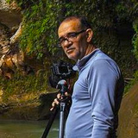

Robert Kent and Augusto Gandia-Ojeda
Ph.D. Syracuse University (Geography) 1983
M.A. University of California, Davis (Geography) 1976
B.A. University of California, Davis (Geography) 1973
Current position:
Professor and Chair of Department of Urban Studies and Planning. James H. Ring Professor of Urban Studies and Planning California State University-Northridge
Research Interests: Urban and regional planning, development planning, cartography/GIS, Los Angeles urban issues, Latin America (esp., Peru, Bolivia, Argentina) , human geography.
Departmento de Planificacion, Oficina de Ordenamiento Territorial
Municipal of Ponce,
Ponce, Puerto Rico (1999)
Augusto Gandia-Ojeda
Robert Kent

Slide 5

Kathleen O’Donnell
  2003 PhD in Business Kent State University
  1987 MBA Miami University of Ohio
  1980 BA Miami University of Ohio
  Currently a professor of marketing at San Francisco State University
  Research interests:
    Advertising
    Shopping behavior
    Coolness
    Pop culture

Slide 6

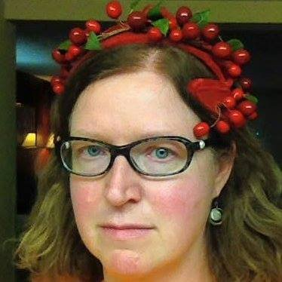
Paul Mullins and Marlys Pearson
  1996 Graduated with PhD from UMASS, Amherst
  1990 MAA (Masters of Applied Anthropology) University of Maryland, College Park
  1984 BS James Madison University
  Currently Professor of Anthropology IUPUI
  Research interests:
    Historical archaeology
    Popular culture
    Race and racism
    Modern material culture
    Urban Midwest
    Finland
From her twitter account:
M.J. Pearson. Writer. Unabashed liberal. Science is real. Create. Resist. Love. Go outside.

Slide 7
Theories
Thing Theory- “is a branch of critical theory that focuses on human–object interactions in literature and culture. It borrows from Heidegger's distinction between objects and things, which posits that an object becomes a thing when it can no longer serve its common function. When an object breaks down or is misused, it sheds its socially encoded value and becomes present to us in new ways through the suspension of habit.” (from Wikipedia)
Criticism-fails to address absence (Fowles and Moran). "non-things, negative spaces, lost or forsaken objects, voids or gaps – absences, in other words, that also stand before us as entity-like presences with which we must contend."^{[7]} For example, Fowles explains how a human subject is required to understand the difference between a set of keys and a missing set of keys, yet this anthropocentric awareness is absent from Thing Theory.” (from Wikipedia)
Actor-Network Theory (ANT)-”is a theoretical and methodological approach to social theory where everything in the social and natural worlds exists in constantly shifting networks of relationships. It posits that nothing exists outside those relationships. All the factors involved in a social situation are on the same level, and thus there are no external social forces beyond what and how the network participants interact at present. Thus, objects, ideas, processes, and any other relevant factors are seen as just as important in creating social situations as humans. ANT holds that social forces do not exist in themselves, and therefore cannot be used to explain social phenomena. Instead, strictly empirical analysis should be undertaken to "describe" rather than "explain" social activity. Only after this can one introduce the concept of social forces, and only as an abstract theoretical concept, not something which genuinely exists in the world.^{[1]} ” (from Wikipedia)

Slide 8
Barbie
Look at Barbies on table and see if you can figure out which ones are the oldest
What are you basing your classification on?
Using article, own experience and dolls in front of you, can you make a thesis about how social ideology on domesticity has shifted from mid-1980s to now?

Slide 9
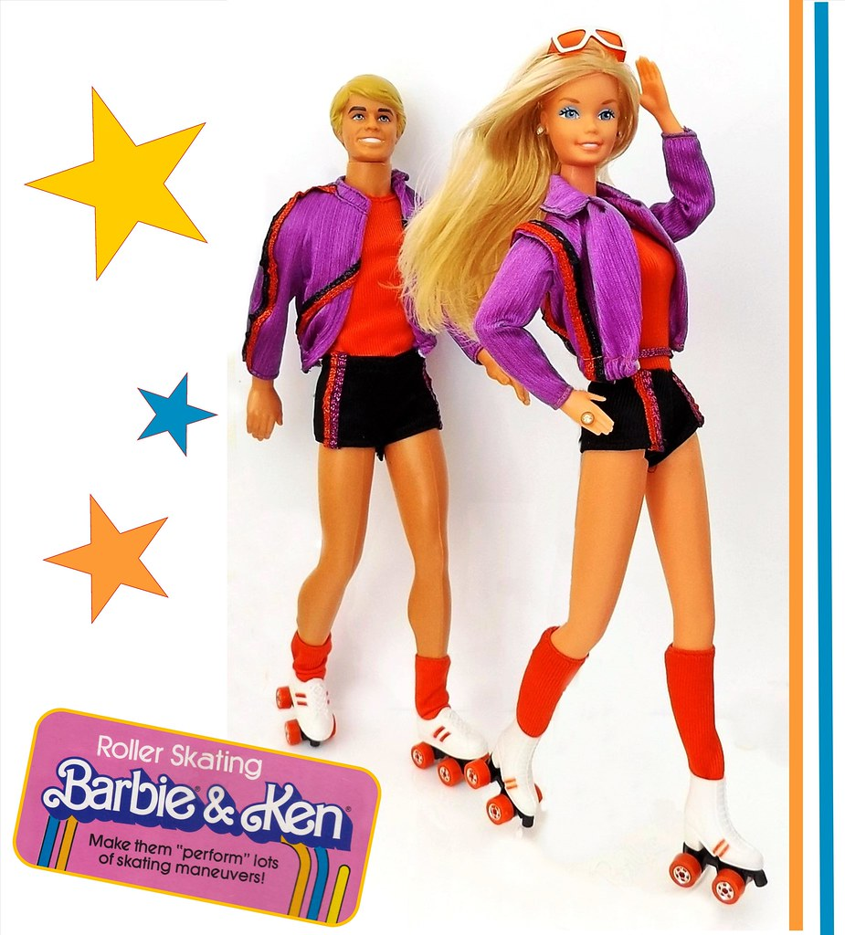
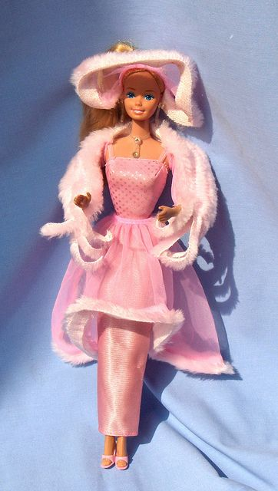
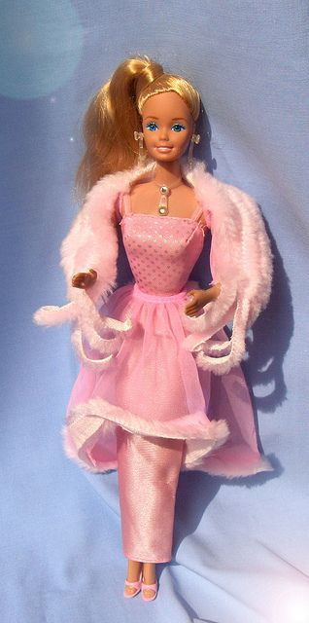
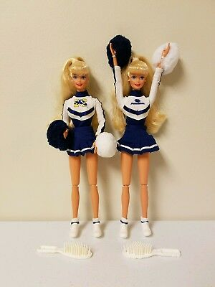
Barbie
https://www.youtube.com/watch?v=w7E1nESMQzQ (hair focus)
Western Barbie commercial (1980) https://www.youtube.com/watch?v=W1eWqlYmZ2A
Roller Skating Barbie (1981)
Pink and Pretty Barbie (1981)
Penn State Barbie (1996)

Slide 10
Digital Humanities Projects
Some examples:
Hypercities: http://www.hypercities.com/
The Welikia Project: https://welikia.org/
Spatial History Project: http://web.stanford.edu/group/spatialhistory/cgi-bin/site/index.php
Visualizing Emancipation: http://dsl.richmond.edu/emancipation/
The Spread of American Slavery: https://lincolnmullen.com/projects/slavery/

Slide 11
Themes
4 groups of 3
Potential Themes based on Smith’s work
  Social
  Ritual
  Political
  Economic
Do we want to look at these 4 themes, or focus on just one?
Name of project?
  My thought-Mapping the Making of the Urban Landscape: Making Place in Bed Stuy

Slide 12
Questions and Comments
Dr. Kelly M Britt
Kellym.britt@Brooklyn.cuny.edu

