Slide 1
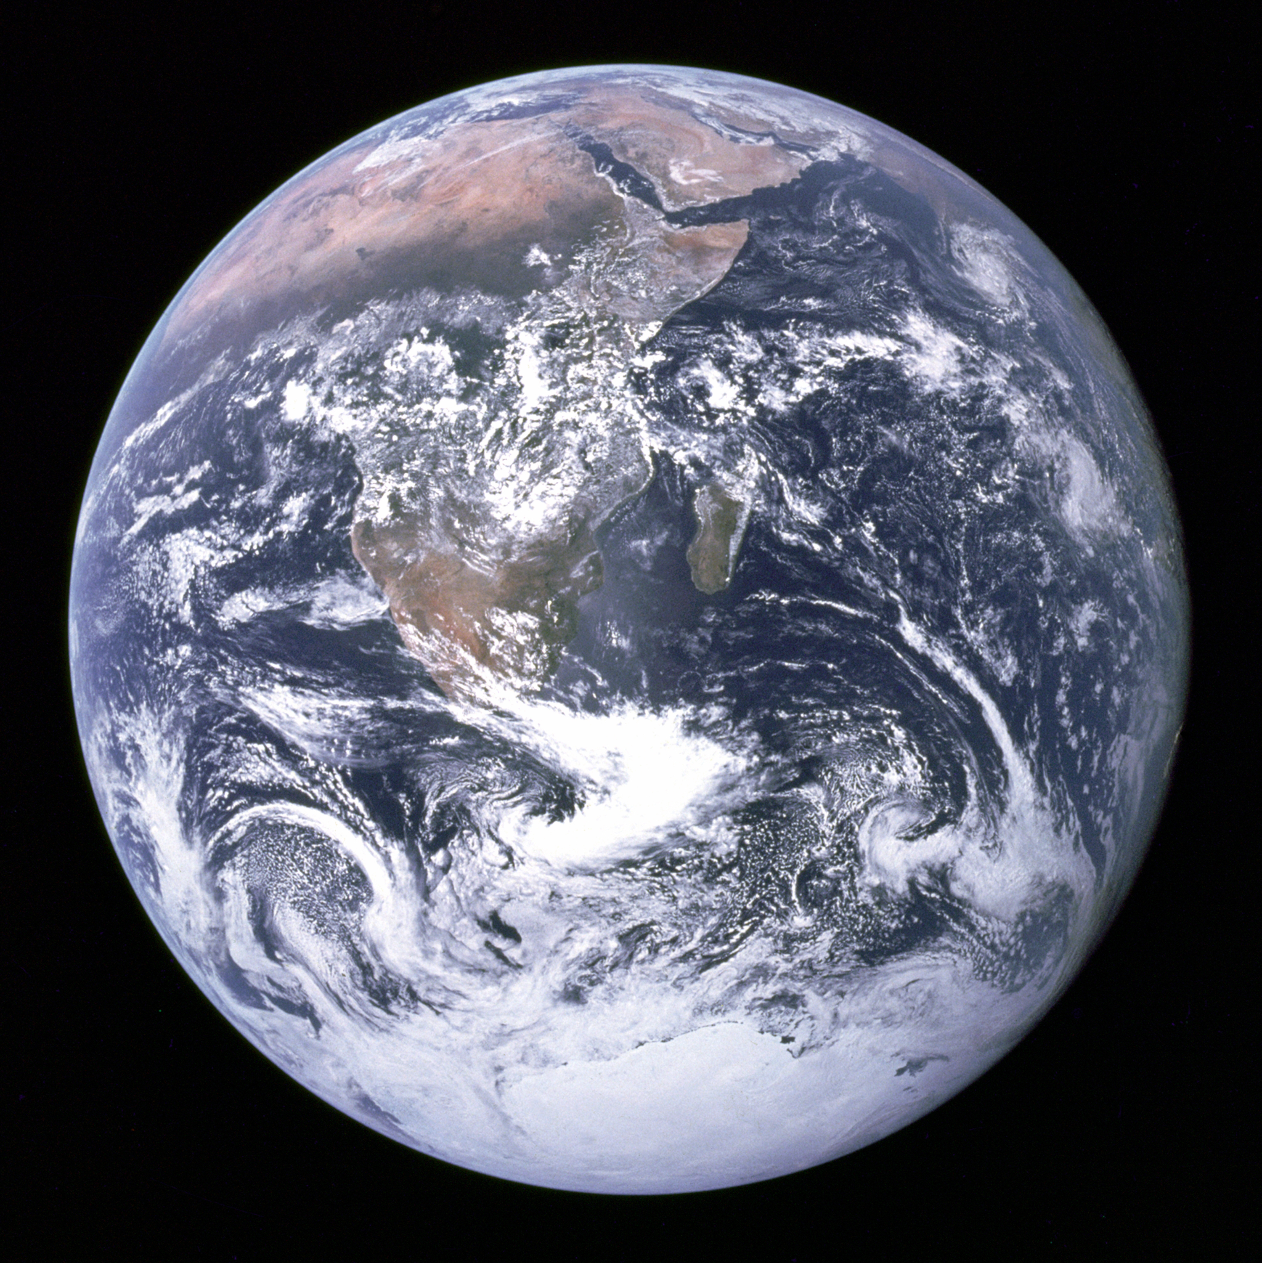
What is Climate Change?

Slide 2
What is Anthropogenic
Climate Change?
Changing the chemical composition of the Earth’s atmosphere (Adding greenhouse gasses like CO2 and CH4 produced by burning fossil fuels, fracking natural gas, and agriculture).
Increasing the average global temperature through human activity.

Slide 3
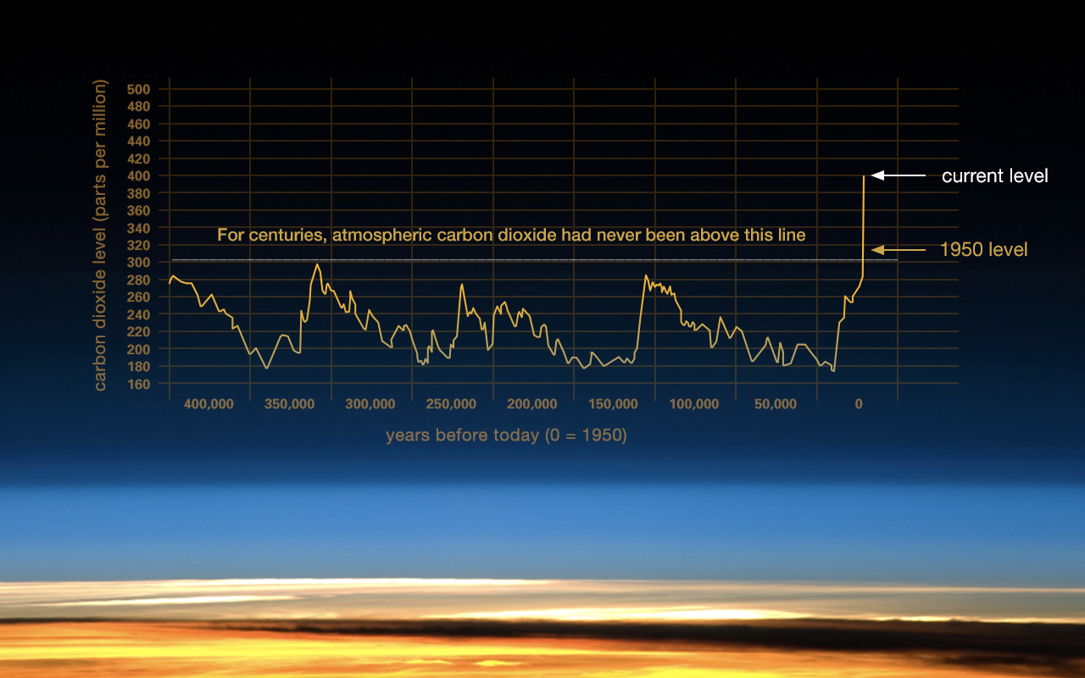
CO2 now at highest level since humans evolved

Slide 4
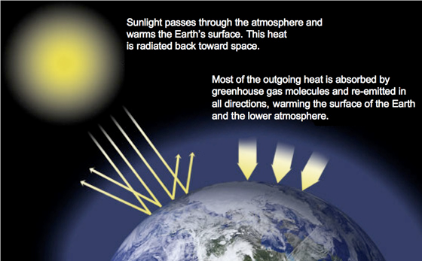
CO2 traps heat from the sun and warms the planet (Greenhouse effect)

Slide 5
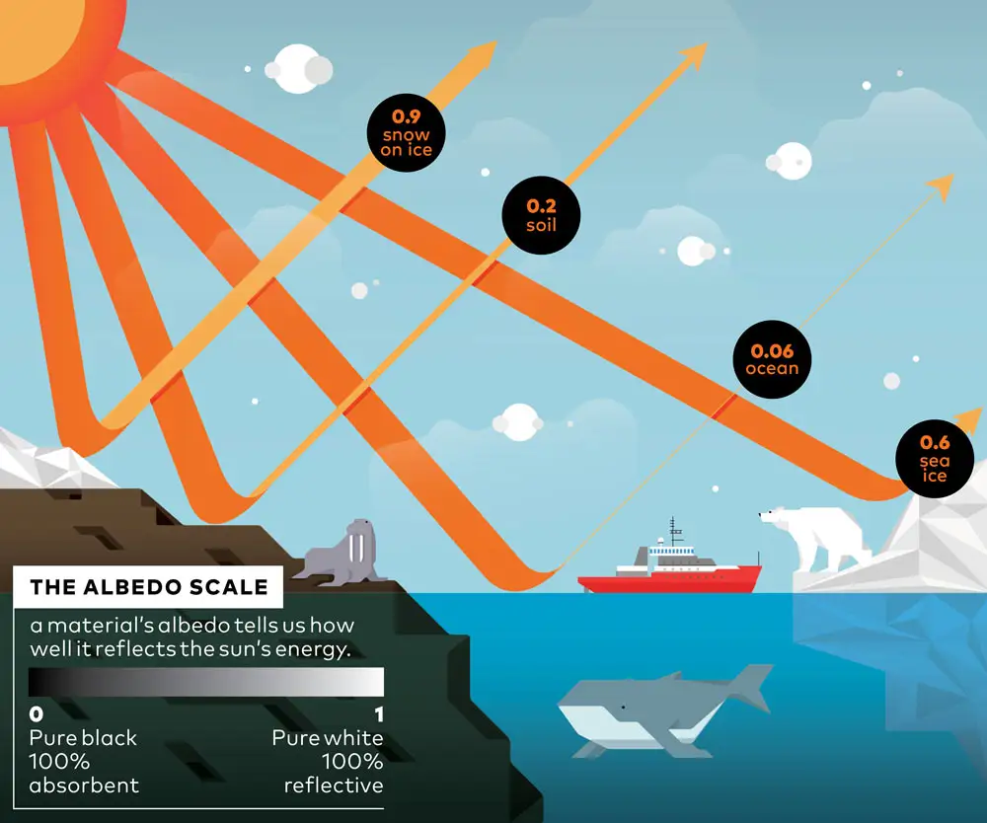
Albedo and Climate Change

Slide 6
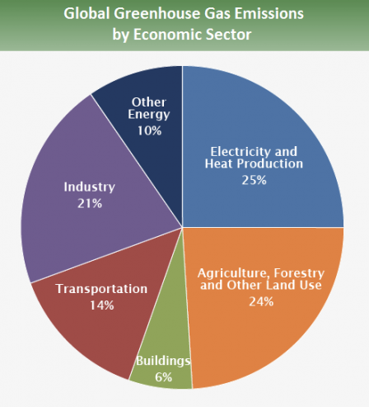
Where do GHGs come from?

Slide 7
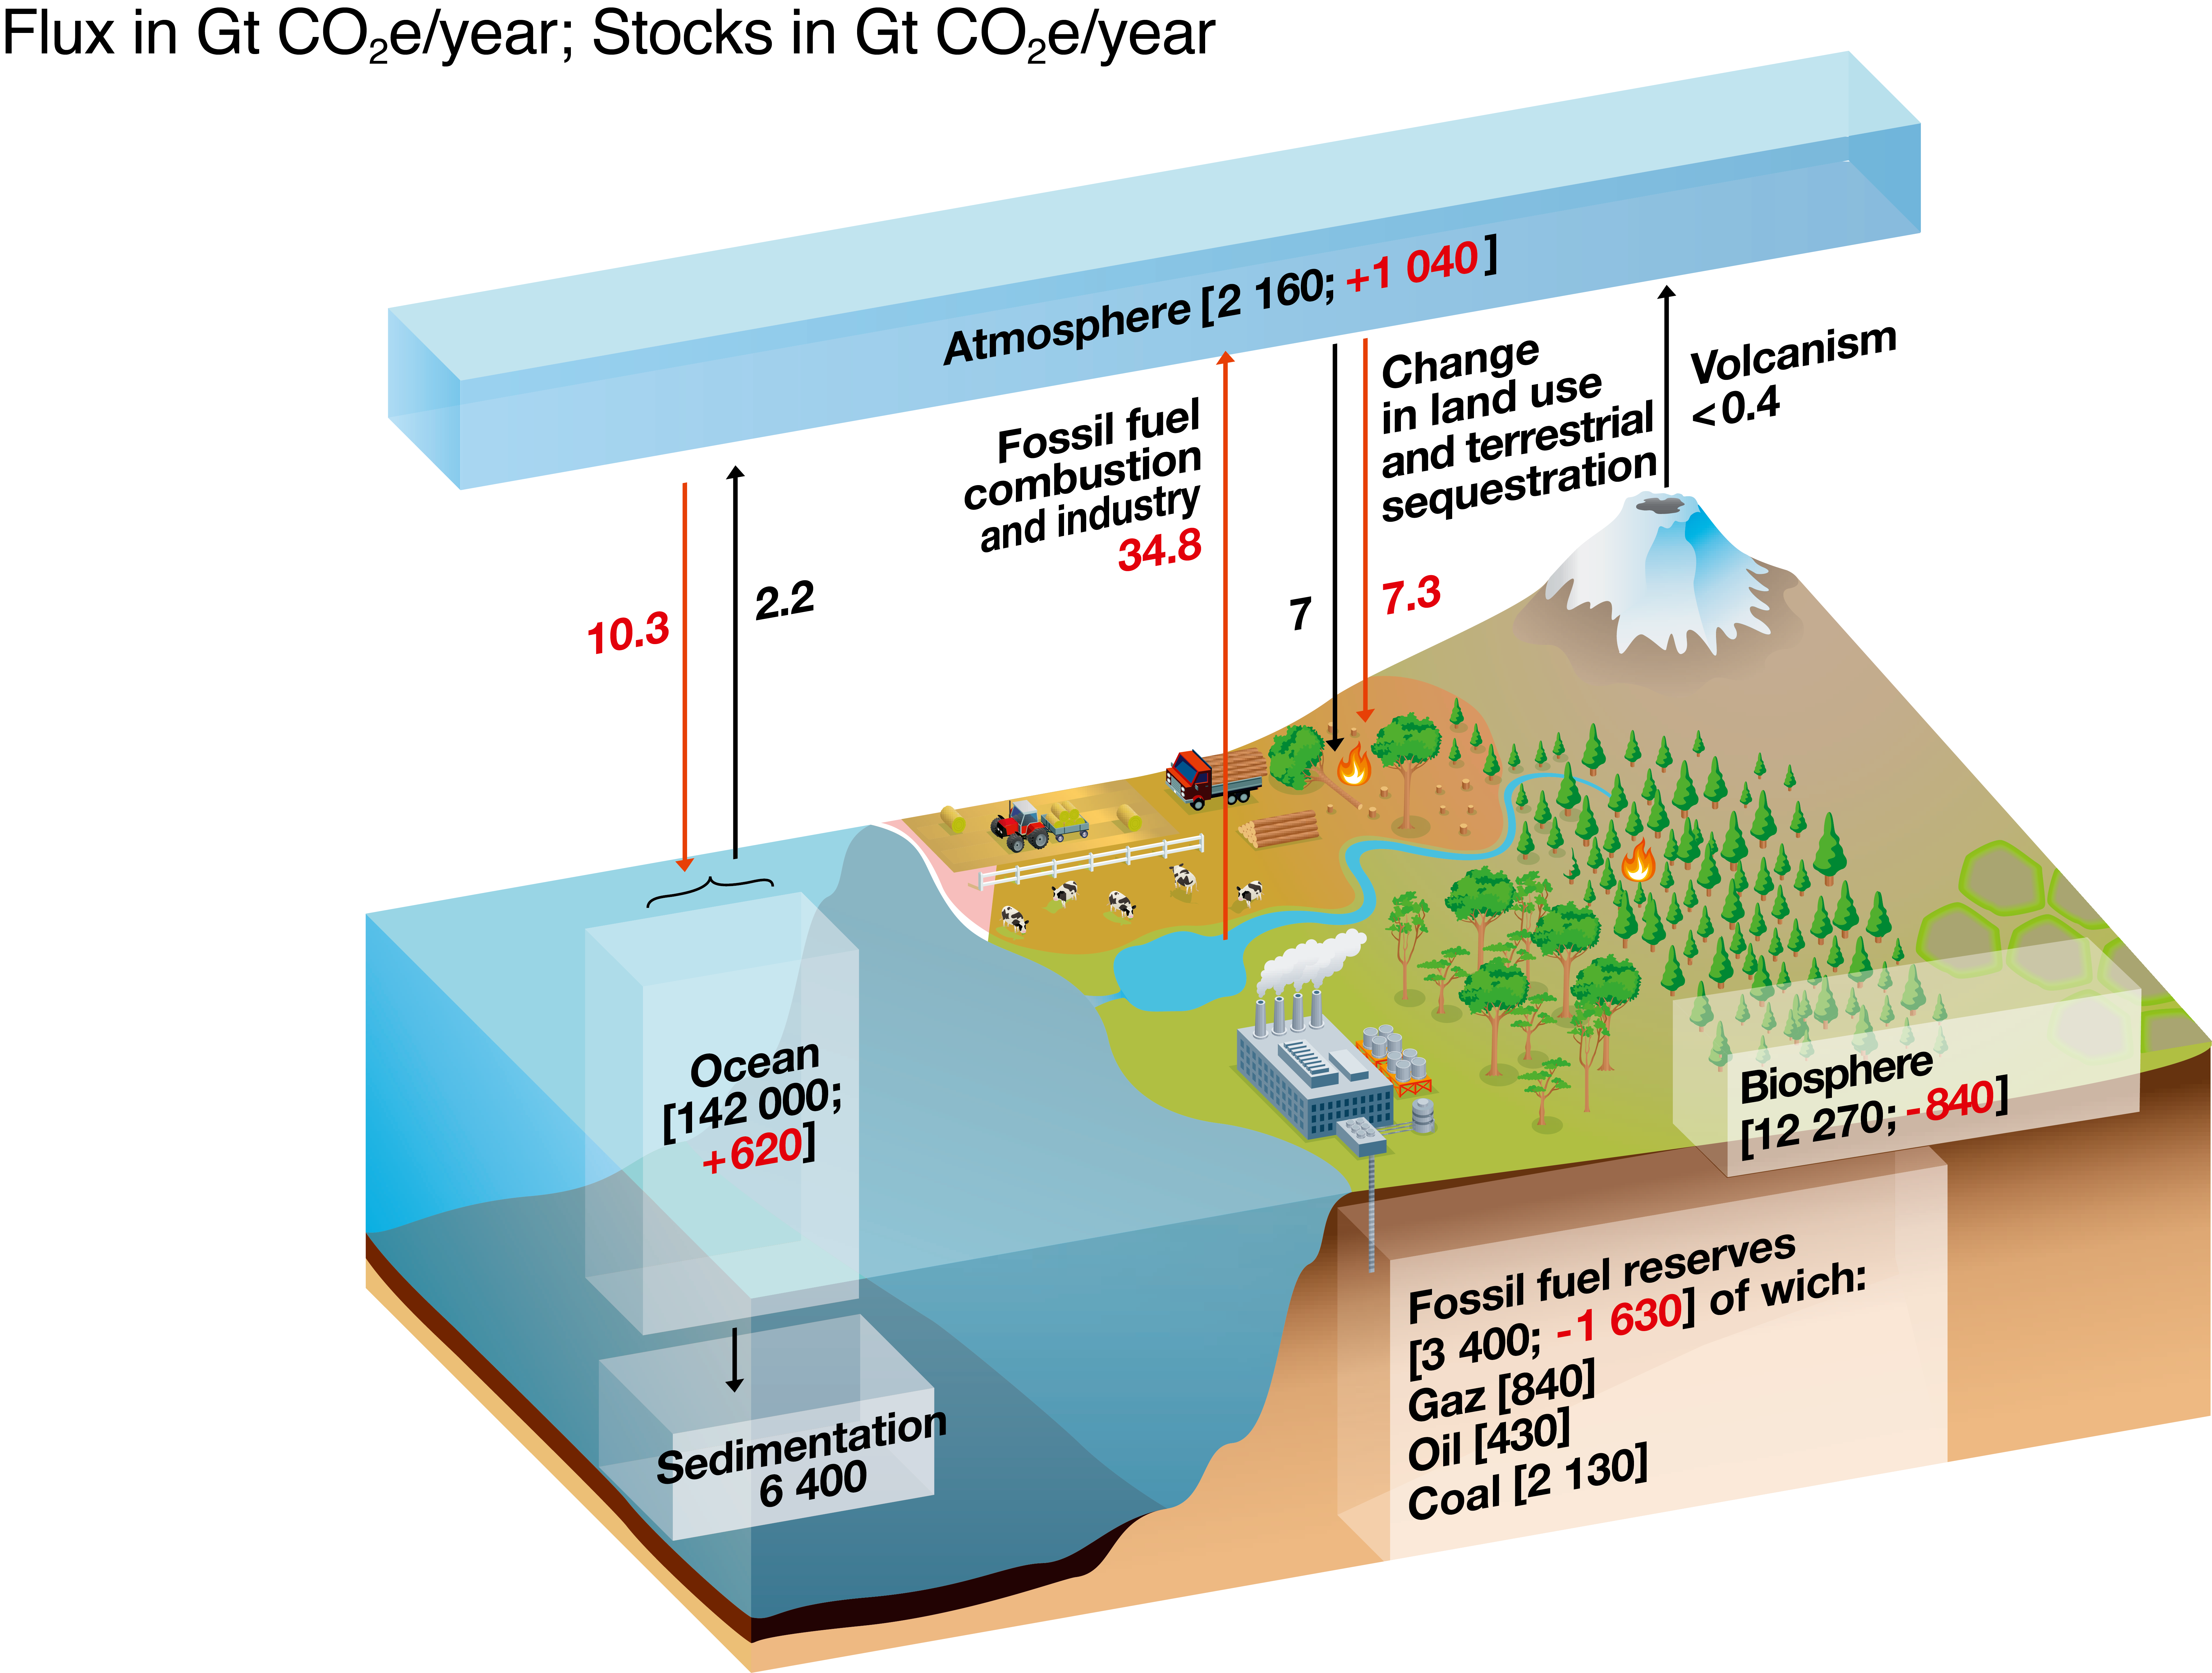
GHG RESERVOIRS AND FLUXES:
EXAMPLE OF CO2 OVER THE YEARS 1750-2019

Slide 8
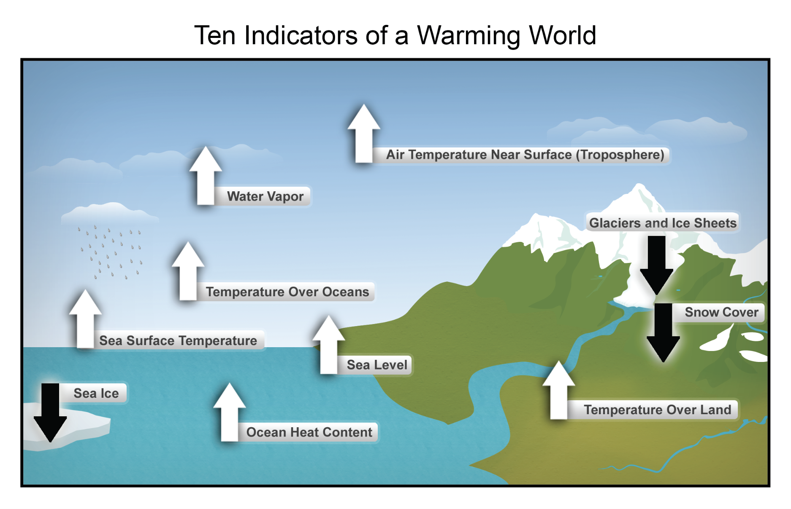
How Earth Systems Respond

Slide 9
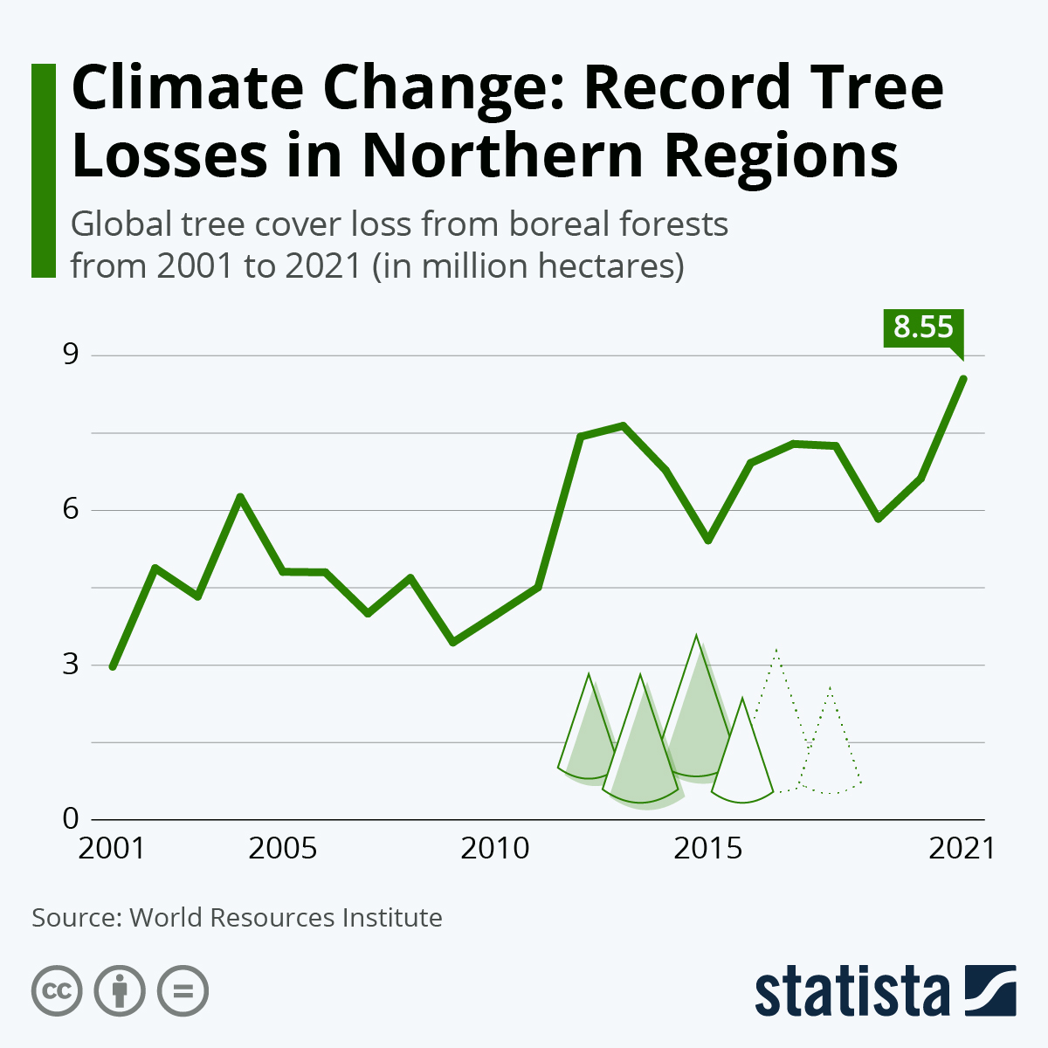
Forest Cover:
Negative Climate Feedback Loop

Slide 10
Shorthand
The ice on our planet is being melted.
The oceans on our planet are being heated.
The forests on our planet are being burned.

Slide 11
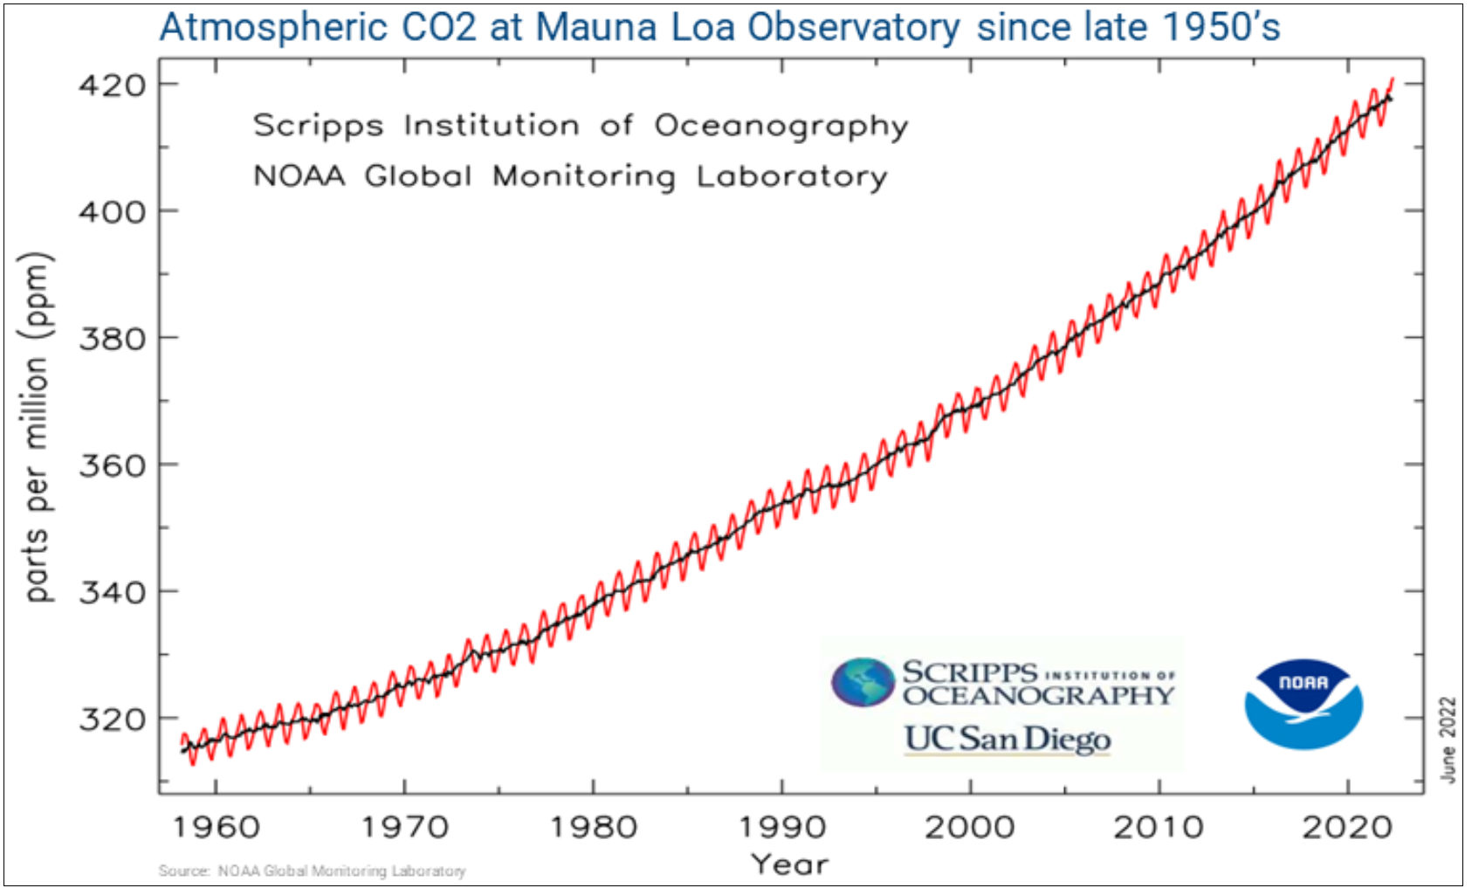
Currently at 423 PPM of CO2

Slide 12
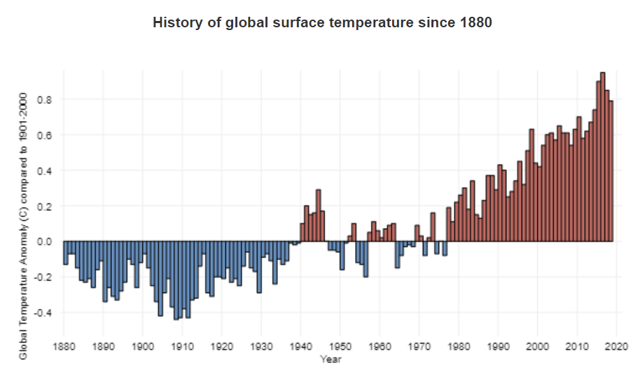
Warming trend tracks with CO2 increases since the industrial revolution

Slide 13
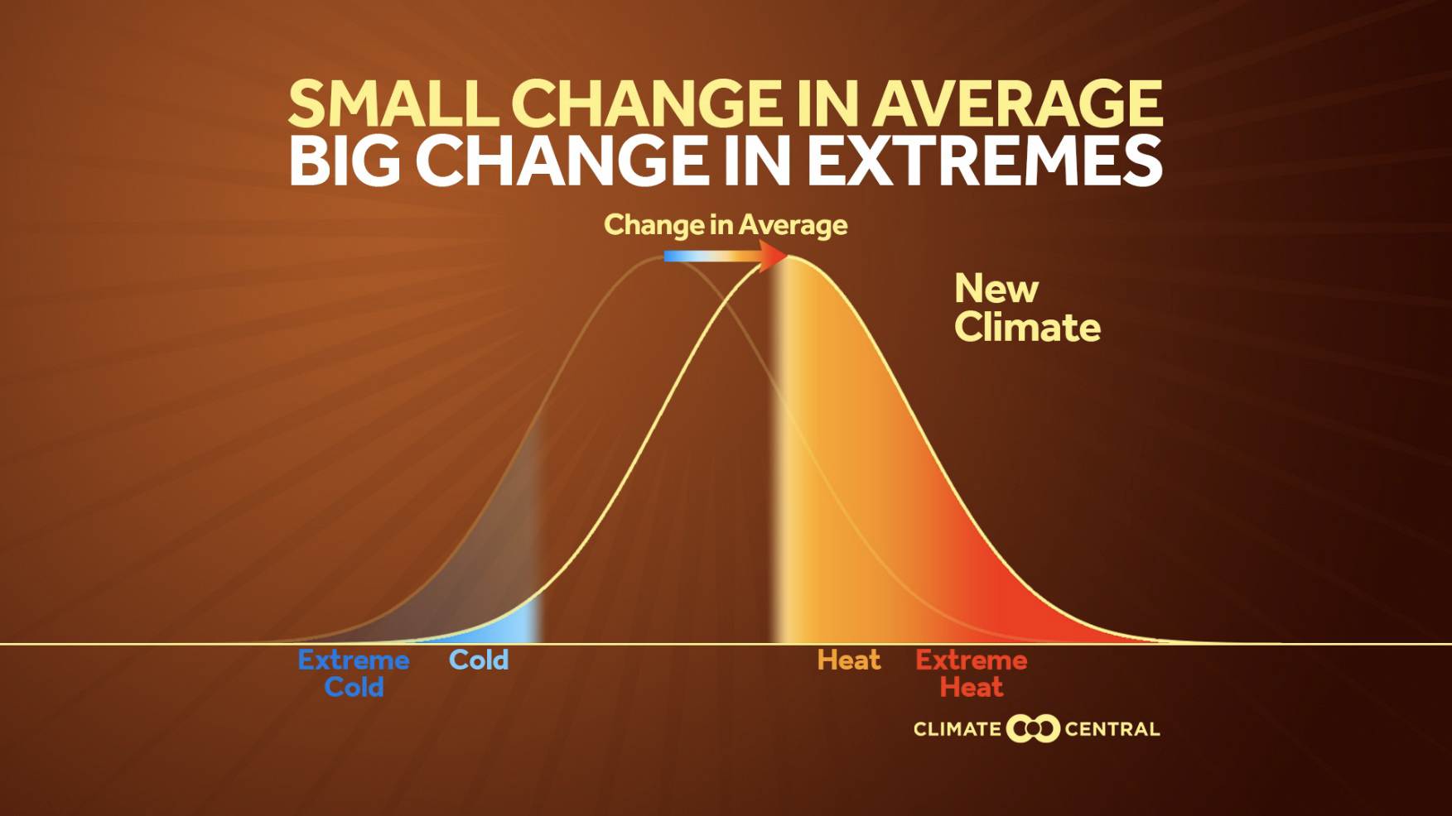
Extreme Events

Slide 14
