Slide 1
State of the Global Environment

Slide 2
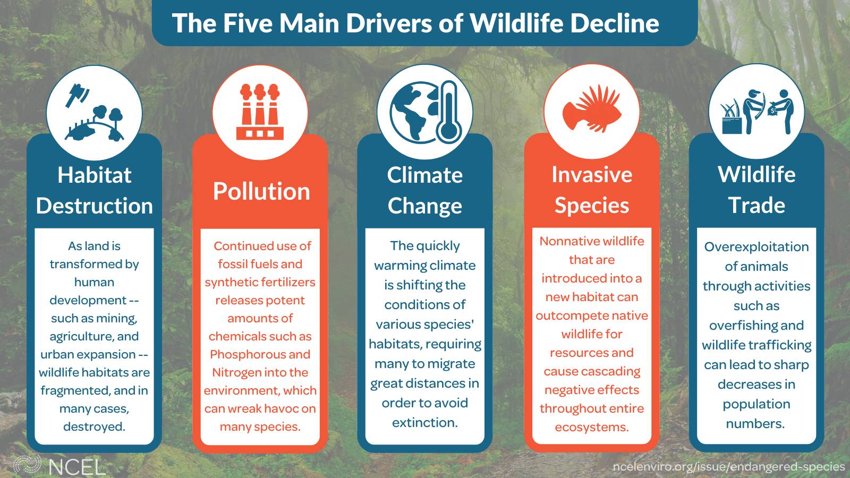
Biodiversity Decline

Slide 3
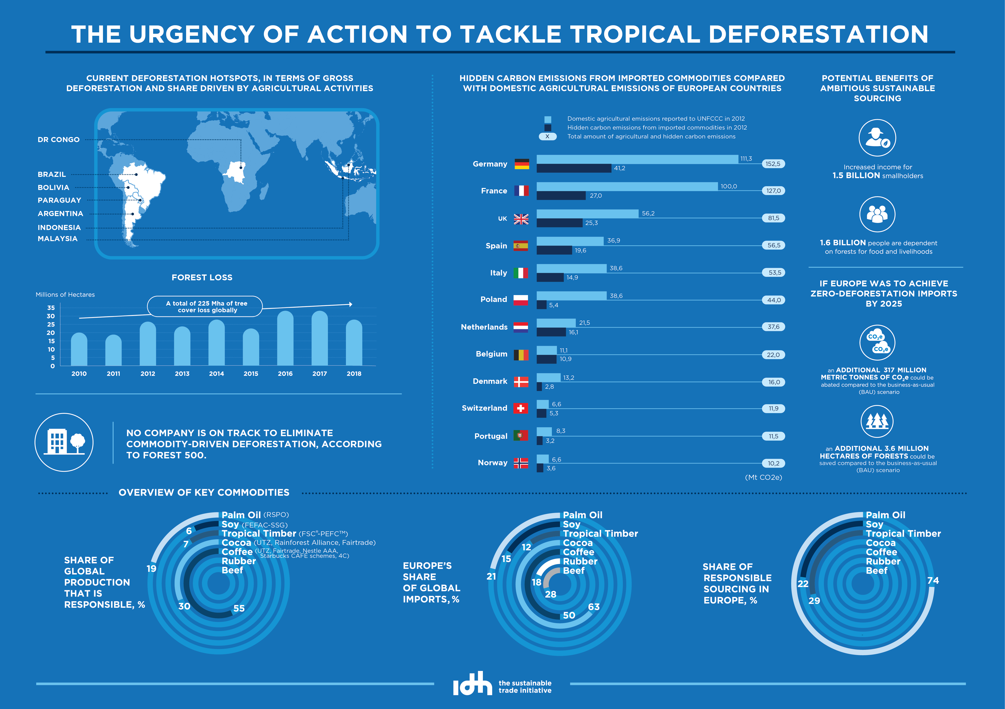
Tropical Deforestation

Slide 4
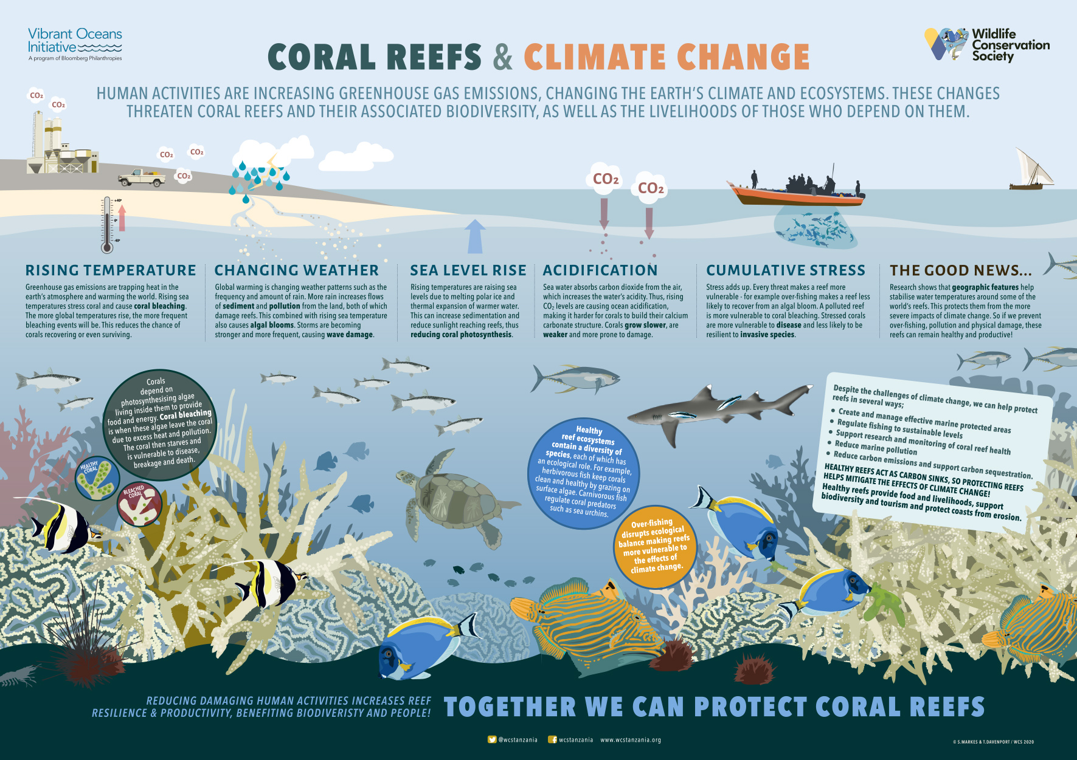
Coral Reef Decline

Slide 5
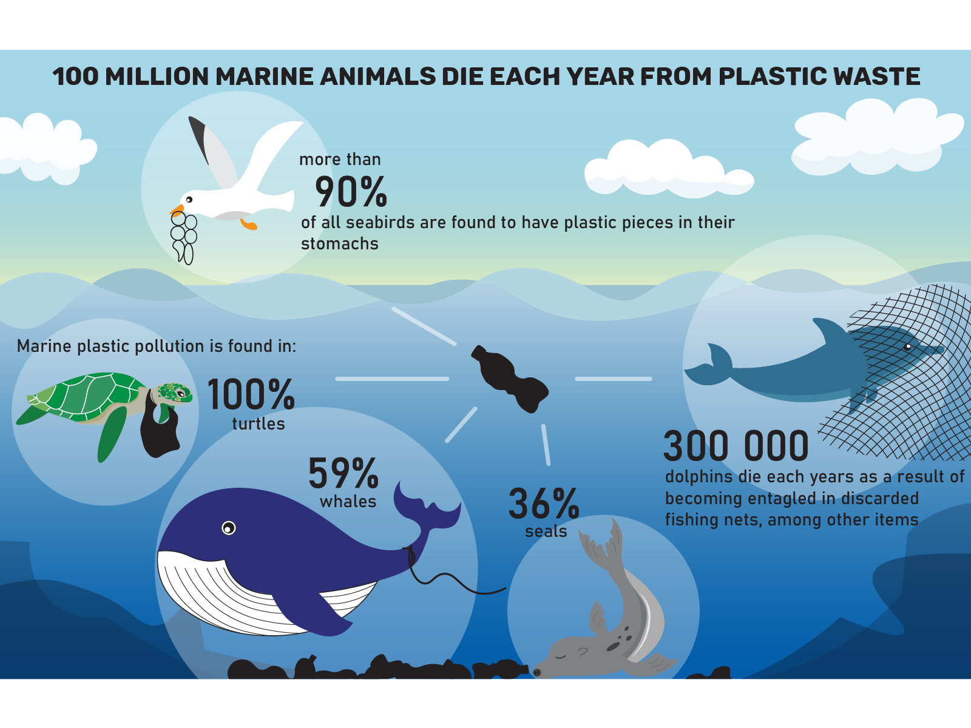
Plastic Pollution

Slide 6
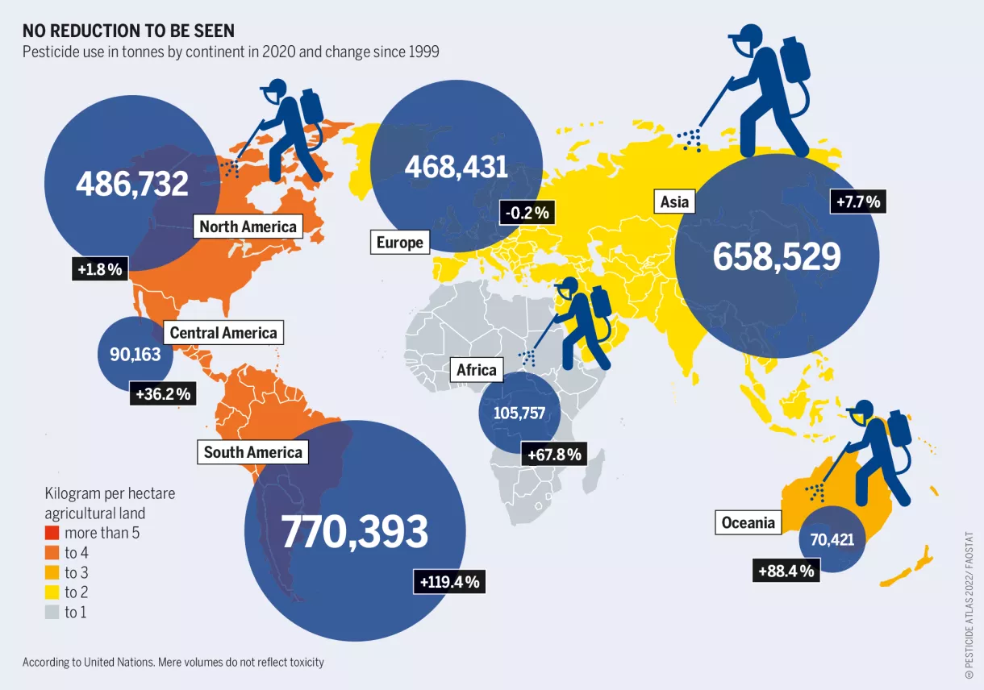
Biocide Pollution

Slide 7
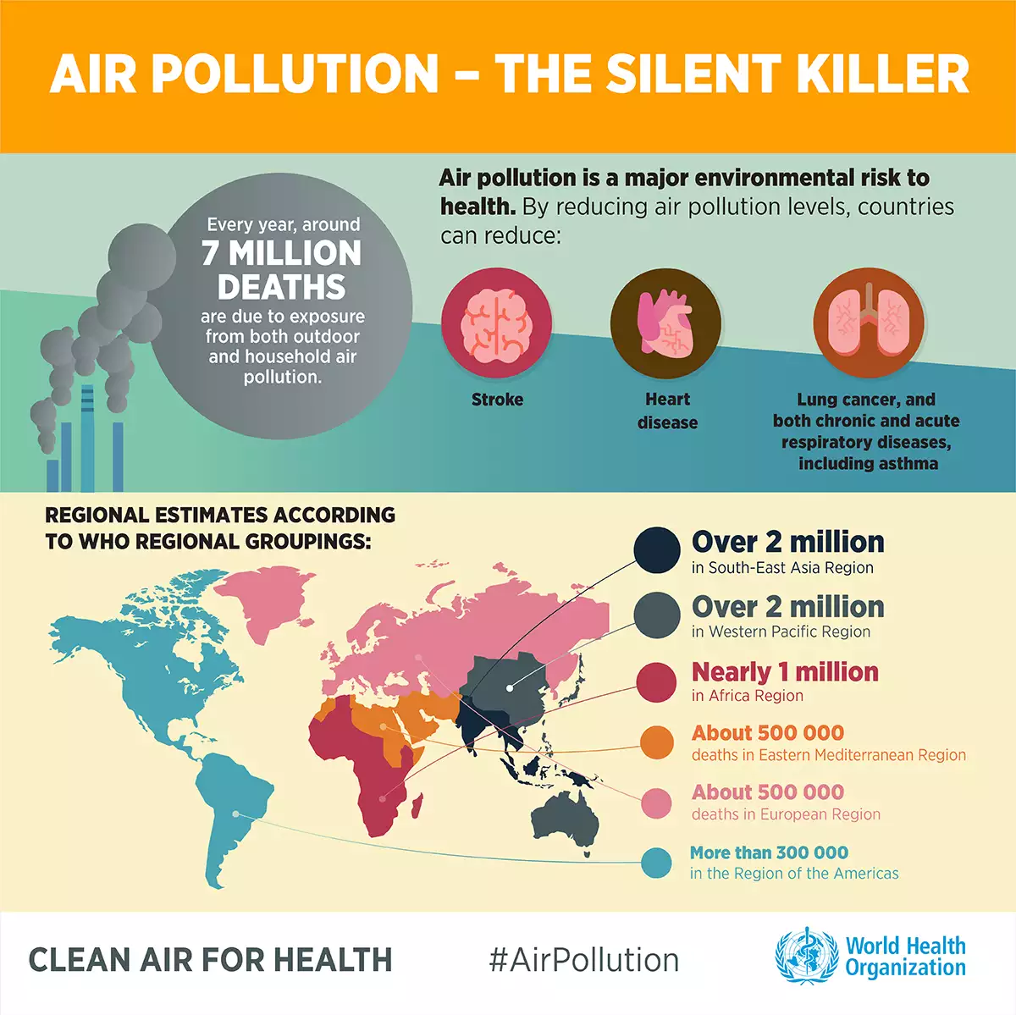
Air Pollution

Slide 8
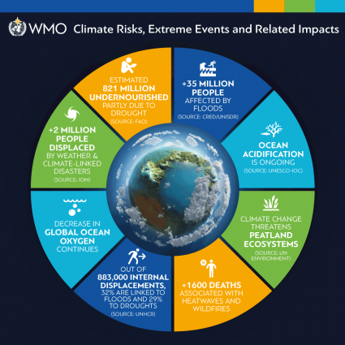
Climate Change Risks

Slide 9
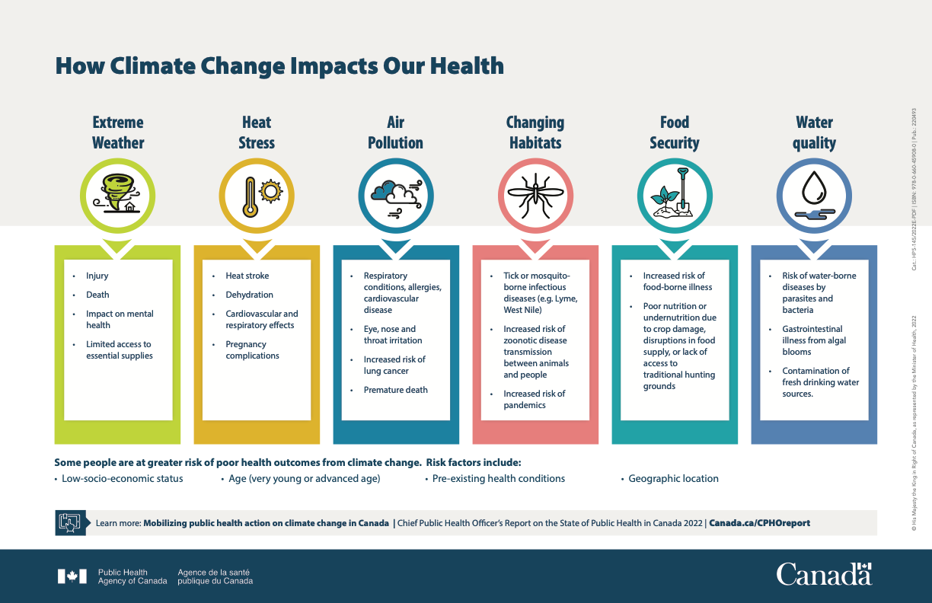
Climate and Health Impacts

Slide 10
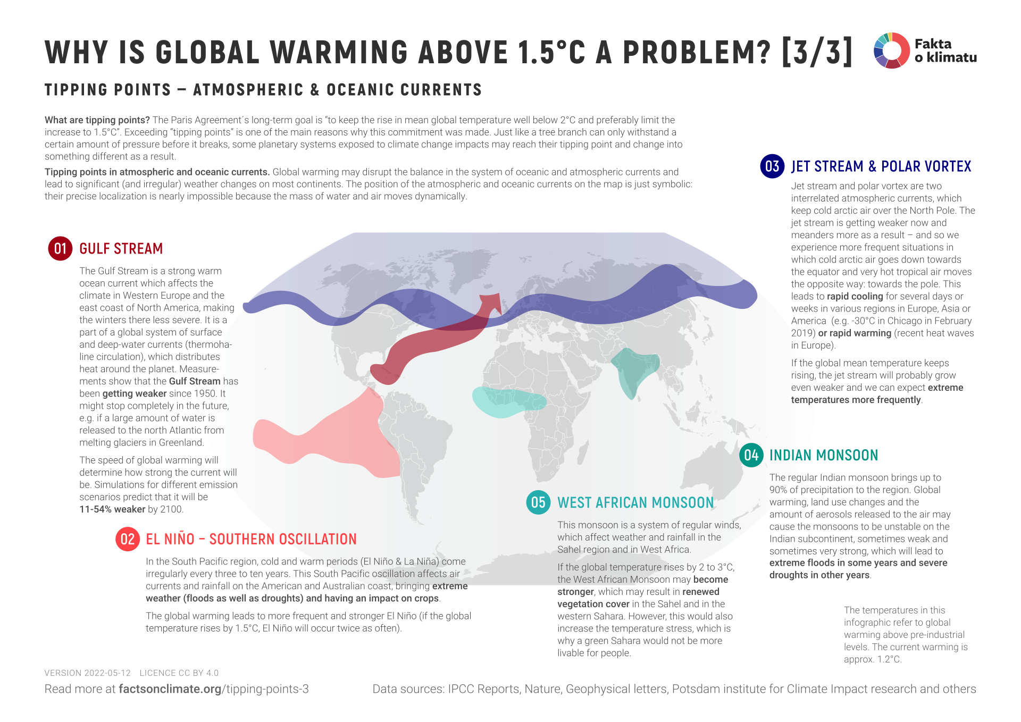
Tipping Points and Climate Change

Slide 11
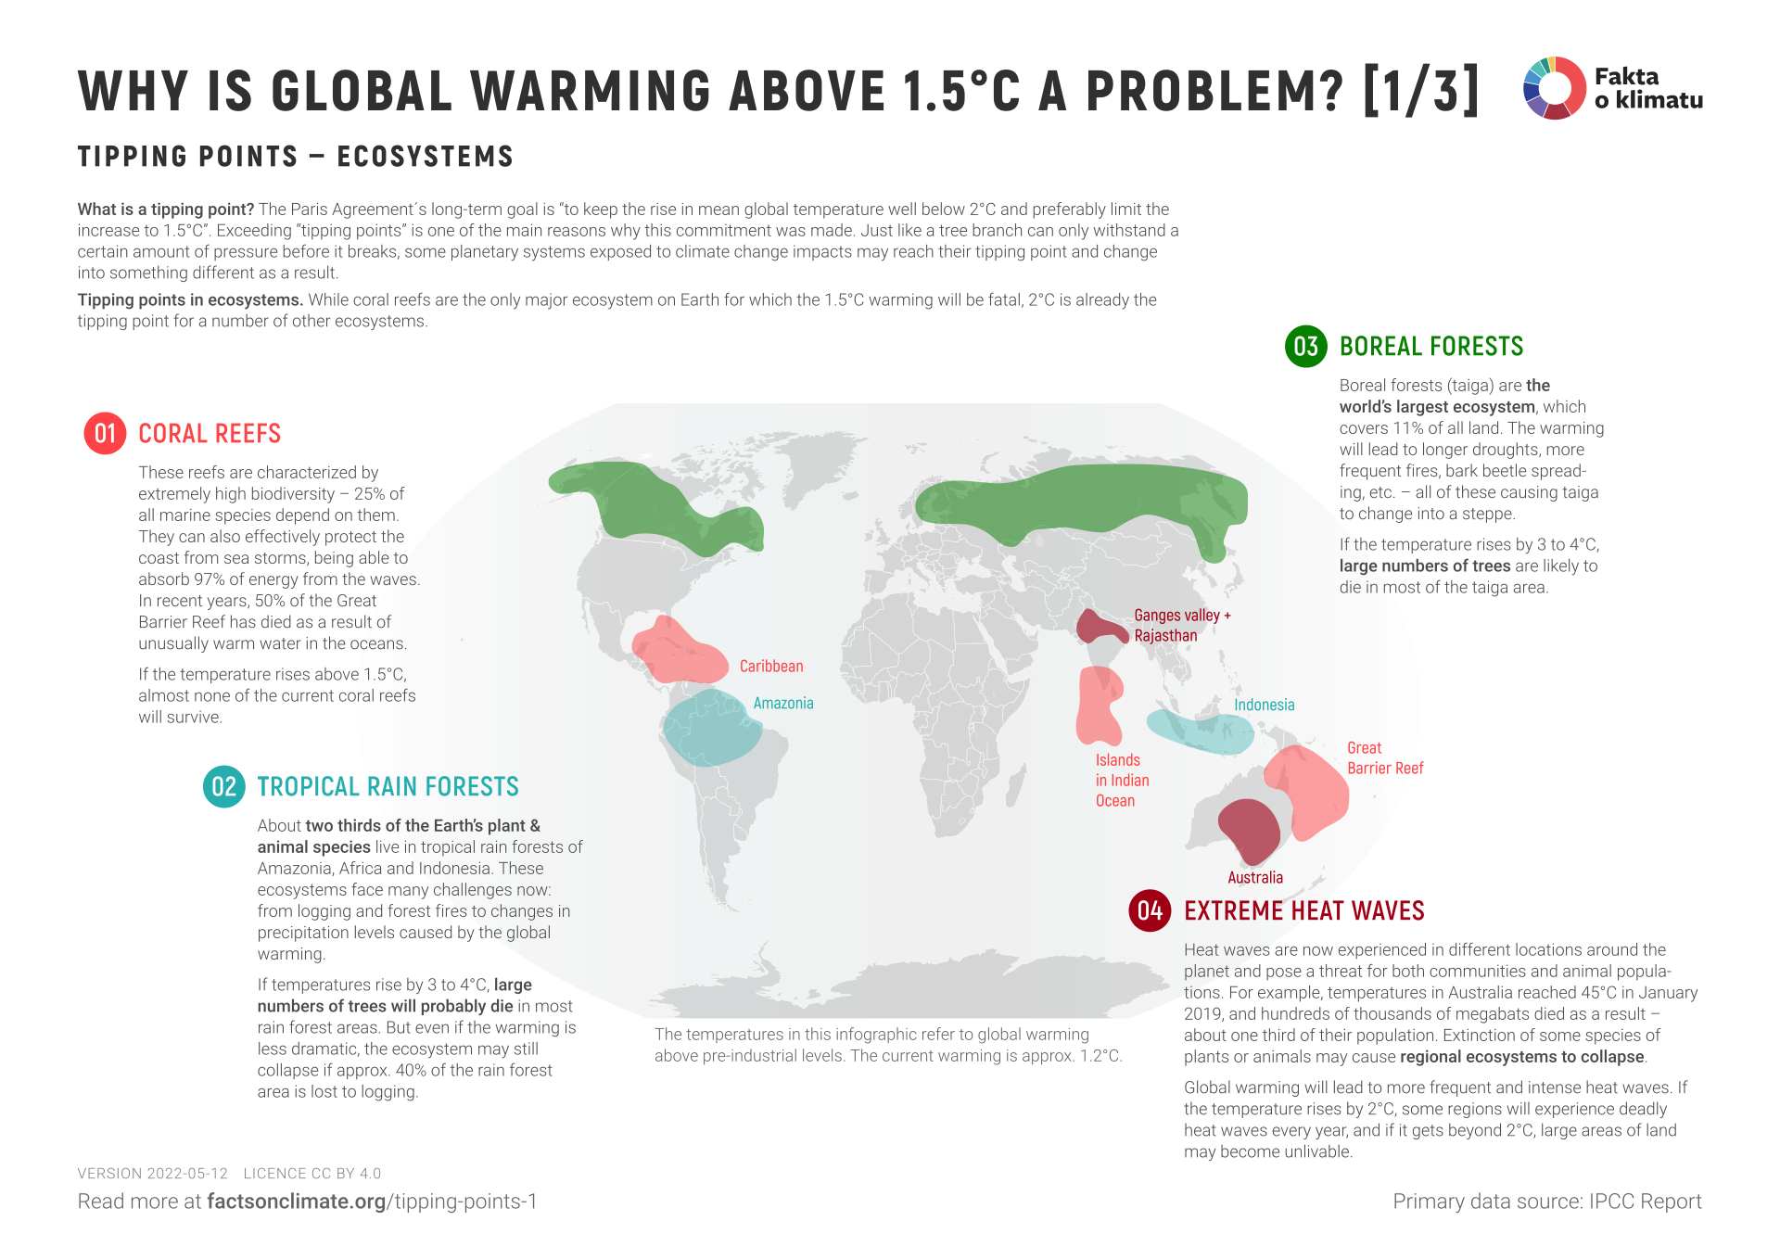
Tipping Points and Climate Change

Slide 12
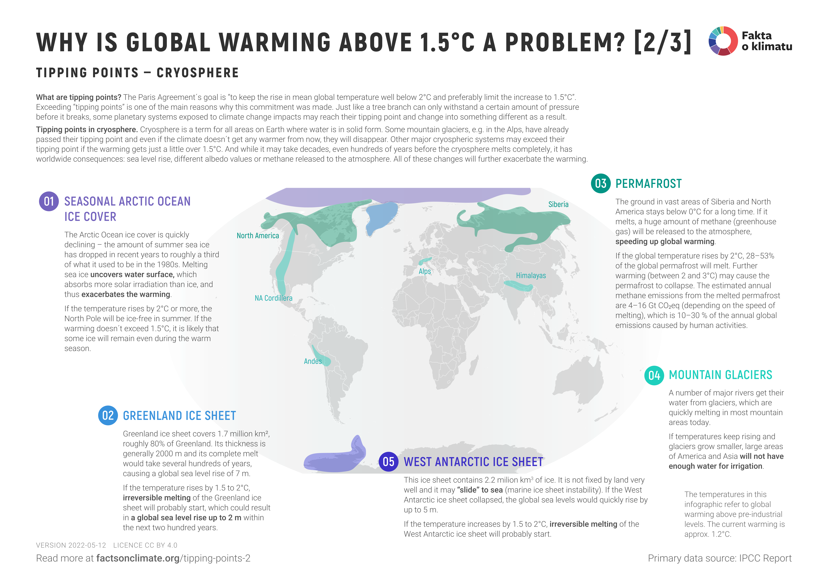
Tipping Points and Climate Change

