Slide 1
ANTH 3420 Urban Archaeology
Prof. Kelly M Britt
Room 538 IA

Slide 2
Announcements
No more office hours.
Last Readings week- Andrew, Paula, James, Kellen and Isabel
Thursday we meet in library in media room. Emily will join us-Room 383.
No readings next week, project presentations
Extra credit-email me for link to Tent’s interview can transcribe 10 minutes. Due Midnight 12/17.

Slide 3
Agenda
Announcements
Discussion over readings:
  Brunwasser-James
  Fowles
  Mendosa-Kellen and Isabel

Slide 4
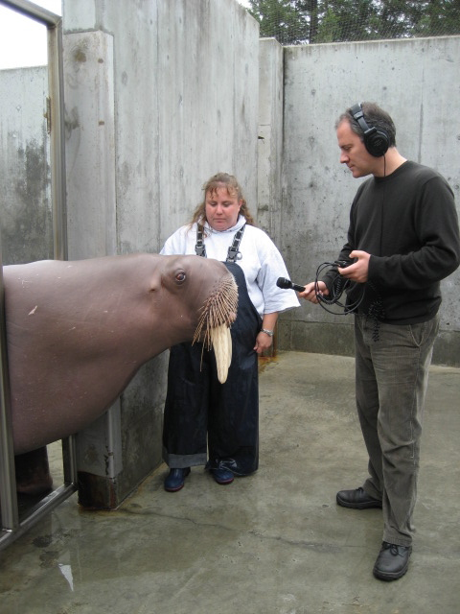
Matthew Brunwasser
Independent journalist based in the Balkans
2014 was an Investigative Reporting Fellow at UCAL Berkeley
Website: https://matthewbrunwasser.com/index.php/bio/
A native of San Francisco, Matthew Brunwasser has a Bachelor of Arts in history from Reed College in Portland, Oregon and a Master of Journalism from the University of California at Berkeley Graduate School of Journalism where he specialized in documentary film production.

Slide 5
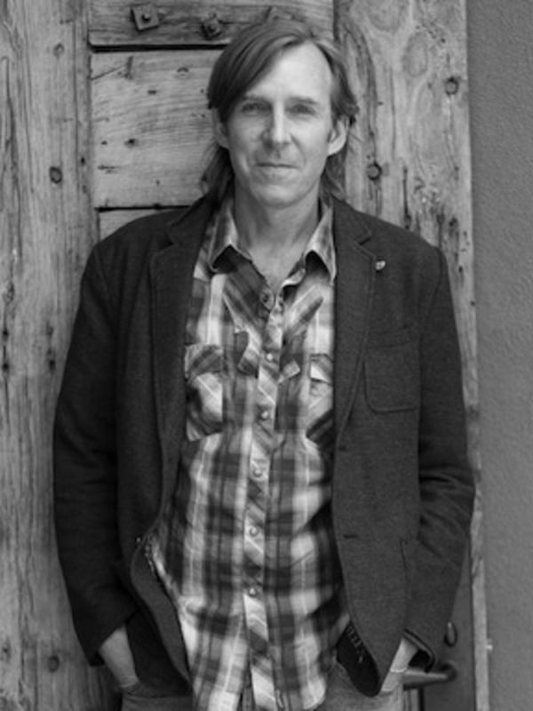
Severin Fowles
Currently Associate Professor and Chair of American Studies and Director of Archaeology Track
2004, PhD University of Michigan, Anthropology andArchaeology
1993, BA Dartmouth, Anthropology
Research Interests:
  Political history
  Counterculture
  Landscape
  Visual culture
  Religion
  Indigenous archaeology
  Native American studies
  American Southwest

Slide 6
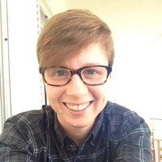
Kaet (Katherine) Heupel
Currently Assistant Dean of Studies, Bard College
Visiting Professor prior
Phd 2015, Columbia University, Anthropology
BA 2006, University of Chicago, Anthropology
Research Interests:
  Experienced educational professional in the areas of teaching, research, problem-solving, communication, facilitation, archaeological survey, ethnographic research, and project coordination. Innovative, creative, and passionate about education, community, and empowering our students to achieve their success.

Slide 7
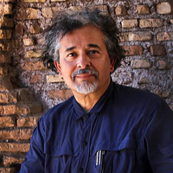
Ruben Mendoza
Currently Professor and Chair of Social, Behavioral & Global Studies, CSU Monterey Bay (there since 1997)
1991-1997-fellowships, Assistant Prof and other titles various institutions
1992 PhD University of Arizona, Anthropology
1980 MA University of Arizona, Anthropology
1978, California State University, Bakersfield
Research Interests (from https://www.researchgate.net/profile/Ruben_Mendoza3):
  He has directed major archaeological and ethnohistorical investigations on the Colorado Front Range, Guanajuato, Mexico, and the Spanish missions of San Juan Bautista, San Carlos Borromeo, San Miguel Arcángel, Nuestra Señora de la Soledad, the Royal Presidio of Monterey, and the 16th century Ex-Convento de la Concepción in Puebla, Mexico.

Slide 8
Questions and Comments
Dr. Kelly M Britt
Kellym.britt@Brooklyn.cuny.edu

