Slide 1
ANTH 3420 Urban Archaeology
Prof. Kelly M Britt
Room 538 IA

Slide 2
Announcements
No more office hours.
This week’s discussants: Andrew, Nolcie and Jared Next week-NO ONE. Last Readings week- Andrew, Paula, James, Isabel and Kellen
Next Week we meet in library with laptops-Room 283.
No readings next week, instead write reflection on Tent’s interview.

Slide 3
Agenda
Instructions for Projects/Papers
Discussion over readings:
  Blake
  Burton and Farrell
  Frederick

Slide 4
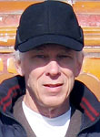
C. F. Blake
Charles Fredric Blake (1942 – 2017), cultural anthropologist
1964 B.A. University of Hawai’i
1966 M.A. Washington University in St. Louis, Missouri
1975 PhD University of Illinois, Urbana-Champaign
He served on the faculty at the University of Hawai’i at Mānoa from 1974 to 2017
University of Hawai’i, Manoa
Research interests:
  Critical and interpretive theory
  Ethnography and biography
  Popular ideologies
  Social movements and entrepreneurship in the modern world economy
  China, U.S.

Slide 5
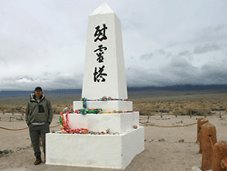
Jeffery F. Burton
Currently Cultural Resources Program Manager at Manzanar National Historic Site

Slide 6
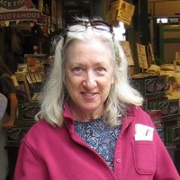
Mary M. Farrell
Currently principal investigator for Trans-Sierran Archaeological Research
Mary Farrell (mollyofarrell@gmail.com) has co-authored several historic resources inventory reports, National Register nominations, and professional archaeological papers about sites associated with the incarceration of Japanese Americans during World War II.
She serves as an instructor for the University of Hawai'i West O'ahu archaeological field methods class at Honouliuli Internment and POW Camp,
and assisted in the preparation of the National Historic Landmark theme study for sites associated with the Japanese American incarceration during World War II and the draft special resources study for Hawaiian sites associated with the incarceration of civilians during World War II.
She believes that archaeology can, and should be, a force for truth, justice, understanding, and peace.
From https://encyclopedia.densho.org/authors/Mary%20M.%20Farrell/

Slide 7
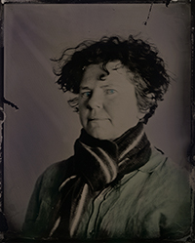
Ursula K. Frederick
Currently at
  Australian National University-RC Discovery Early Career Researcher Award Fellow
  University of Sydney, Faculty Member
  Flinders University of South Australia, Adjunct Research Associate (?)
PhD, Visual Arts Australian National University
MA, Australian National University
BA, University of West Alabama
Cert Photography (MLTC)
Research Interests-Interdisciplinary:
  Photography
  Material culture
  Automobilities
  Visual anthropology
  Graffiti
  Alternative processes
  Cultural heritage
  Contemporary archaeologies
  Environmental art

Slide 8
Questions and Comments
Dr. Kelly M Britt
Kellym.britt@Brooklyn.cuny.edu

