Slide 1
Designing Effective Syllabi and Assignments
17th Annual Orientation Session
for Teaching Interns, August 23rd, 2010
Breakout Workshop 1
Benjamin Miller bmiller@gc.cuny.edu
Benjamin Miller bmiller@gc.cuny.edu

Slide 2
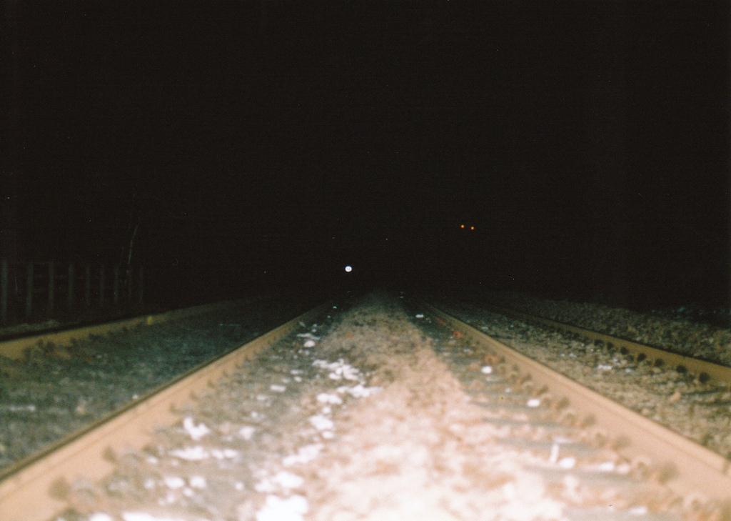
Being on Rails
Sometimes it’s enough that someone else have a clear idea of where you are, and where you’re going.
As a teacher, that someone has to be you.
Photo by joecooke, via flickr

Slide 3
Where We’re Going
Designing an assignment prompt
Breaking it down into tasks and skills
Filling in the calendar, from back to front

Slide 4
Designing an assignment prompt
Core assumption: what students read and what students write should inform each other.
  And since the writing is where they put learning into practice, it will often help to start with the writing assignments first (even as we recognize that we’ll revise later, when we start to fill in the readings).
➢ What final project should a student be capable of by the end of your course? Take five minutes to begin inkshedding an answer.
Inkshedding: writing quickly, trying to let your hand catch up to the speed of your thoughts, open to the possibility that your thoughts may surprise you, and – this is important – aware that you may be asked to share what you’ve written with your peers.

Slide 5
Designing an assignment prompt
John Bean, in Engaging Ideas, recommends that any well-developed prompt explain the following sub-elements:
  The task, i.e. “a problem or question for the student to address, a thesis to support [or critique], or a rhetorical mode or form to follow” (84).
  Role and audience, i.e. how much should students assume their audience knows about the subject at hand? Are they themselves, writing to you? To each other? Are they pretending to be someone else? Are you?
  Format, i.e. expected length, citation style, spacing, how to submit, etc.
  Process expectations, i.e. when drafts are due, and of what kind: A series of inksheds? Quotations-and-responses? Something more formal? A(n annotated) bibliography? Peer review letters? Save all drafts!
  Criteria for evaluation, which we could spend an entire separate breakout session on (and more).
Here, for example, are two prompts I used in Spring 2010…

Slide 6
Designing an assignment prompt
John Bean, in Engaging Ideas, recommends that any well-developed prompt explain the following sub-elements:
  The task, i.e. “a problem or question for the student to address, a thesis to support [or critique], or a rhetorical mode or form to follow” (84).
  Role and audience, i.e. how much should students assume their audience knows about the subject at hand? Are they themselves, writing to you? To each other? Are they pretending to be someone else? Are you?
  Format, i.e. expected length, citation style, spacing, how to submit, etc.
  Process expectations, i.e. when drafts are due, and of what kind: A series of inksheds? Quotations-and-responses? Something more formal? A(n annotated) bibliography? Peer review letters? Save all drafts!
  Criteria for evaluation, which we could spend an entire separate breakout session on (and more).
➢ Let’s discuss the prompt for Shaped Piece 4: First impressions? Can you identify the task? E.g. How will students know if they’ve done it?
Here, for example, are two prompts I used in Spring 2010…

Slide 7
Designing an assignment prompt
John Bean, in Engaging Ideas, recommends that any well-developed prompt explain the following sub-elements:
  The task, i.e. “a problem or question for the student to address, a thesis to support [or critique], or a rhetorical mode or form to follow” (84).
  Role and audience, i.e. how much should students assume their audience knows about the subject at hand? Are they themselves, writing to you? To each other? Are they pretending to be someone else? Are you?
  Format, i.e. expected length, citation style, spacing, how to submit, etc.
  Process expectations, i.e. when drafts are due, and of what kind: A series of inksheds? Quotations-and-responses? Something more formal? A(n annotated) bibliography? Peer review letters? Save all drafts!
  Criteria for evaluation, which we could spend an entire separate breakout session on (and more).
➢ In pairs, share your inksheds/ prompts. Help each other flesh out the task, especially: what concrete problem/question will students address?

Slide 8
Designing an assignment prompt
John Bean, in Engaging Ideas, recommends that any well-developed prompt explain the following sub-elements:
  The task, i.e. “a problem or question for the student to address, a thesis to support [or critique], or a rhetorical mode or form to follow” (84).
  Role and audience, i.e. how much should students assume their audience knows about the subject at hand? Are they themselves, writing to you? To each other? Are they pretending to be someone else? Are you?
  Format, i.e. expected length, citation style, spacing, how to submit, etc.
  Process expectations, i.e. when drafts are due, and of what kind: A series of inksheds? Quotations-and-responses? Something more formal? A(n annotated) bibliography? Peer review letters? Save all drafts!
  Criteria for evaluation, which we could spend an entire separate breakout session on (and more).
➢ In pairs, share your inksheds/ prompts. Help each other flesh out the task, especially: what concrete problem/question will students address?

Slide 9
Where We’re Going
Designing an assignment prompt
Breaking it down into tasks and skills
Filling in the calendar, from back to front

Slide 10
Breaking it down into tasks and skills
➢ All together now, let’s revisit and break down one of my prompts: Shaped Piece 3, “Widening the Conversations.” What must a student do and/or understand to complete this project? Let’s just make a quick list.
Working with the same partners as before, repeat the exercise with your own assignment: What must a student do and/or understand to complete this project? Again, just write a list. Take 10 minutes.
EXT: If you finish early, add order to the list. What skills/tasks are precursors to the others? What tasks/projects can be built out of, or on top of, what other tasks/skills? Do any skills seem applicable to nearly everything else? Take about 5-10 minutes.

Slide 11
Where We’re Going
Designing an assignment prompt
Breaking it down into tasks and skills
Filling in the calendar, from back to front

Slide 12
Filling in the Calendar
There are two worksheets coming around:
  One that assumes two classes per week;
  One that assumes three classes per week.
  Take enough to get up to 15 weeks.
Also coming around: the academic calendar (to fill in holidays, etc).
1. Fill in the dates that are relevant to you.
2. Working in pencil (ideally), fill in the last deadline of the semester.
3. Work backwards from there, filling in deadlines of earlier steps; remember to leave time for responding to students in between.
4. How many other major pieces will (or must) students write? Fill in deadlines for those, too.
5. Hit the beginning of the semester? Hence the pencil. Reverse and move forward through the semester, revising deadlines as needed.

Slide 13
Useful Online Resources
Writing Program Administrators’ Outcomes Statement – http://www.wpacouncil.org/positions/outcomes.html
  Guidelines for “the common [writing] knowledge, skills, and attitudes” students should have by the end of their first year… and how all teachers can help.
Teaching With Writing, by Kerry Walk – http://www.princeton.edu/writing/university/resources/TWW.pdf
  A slim online book with chapters on Sequencing Assignments, Crafting Assignments, designing Writing Workshops, and more.
Shelley Reid’s Resources for Writing Teachers – http://mason.gmu.edu/~ereid1/teachers/tchresources.htm
  But not just for first-year comp teachers: Reid’s Assignments to Aid Critical Reading are especially great, as are the tips for Engaging Students in Discussion.
And feel free to email me: Benjamin Miller bmiller@gc.cuny.edu

Slide 14
Also Useful Resources
Adjunct Lifeline – http://adjunctlifeline.blogspot.com/
  A blog, organized by GC’s own Nichole Stanford, with resources to support adjunct instructors and the like (including GTFs). Check out, e.g. “Some Teaching Mistakes Other People Have Made (So You Don’t Have to)”
Bean, John C. Engaging Ideas: The Professor’s Guide to Integrating Writing, Critical Thinking, and Active Learning in the Classroom. San Francisco: Jossey-Bass, 2001.
  Chock-full of exercises and explanations for encouraging meaningful reflection and assessment through writing, with examples from across the curriculum.
This Power-Point –
http://commons.gc.cuny.edu/groups/gc-comp-rhet-area-group
  Click through to the wiki, and follow the links to Summer Teaching Workshop
And feel free to email me: Benjamin Miller bmiller@gc.cuny.edu

Slide 15
For further consideration:
The WPA Outcomes Statement
WPA: Writing Program Administration 23.1/2 (fall/winter 1999): 59-66. Amended July 2008.
from the Introduction:
This statement describes the common knowledge, skills, and attitudes sought by first-year composition programs in American postsecondary education. To some extent, we seek to regularize what can be expected to be taught in first-year composition; to this end the document is not merely a compilation or summary of what currently takes place. Rather, the following statement articulates what composition teachers nationwide have learned from practice, research, and theory. This document intentionally defines only "outcomes," or types of results, and not "standards," or precise levels of achievement. The setting of standards should be left to specific institutions or specific groups of institutions.

Slide 16
The WPA Outcomes Statement
WPA: Writing Program Administration 23.1/2 (fall/winter 1999): 59-66. Amended July 2008.
from the Introduction:
This statement describes the common knowledge, skills, and attitudes sought by first-year composition programs in American postsecondary education. To some extent, we seek to regularize what can be expected to be taught in first-year composition; to this end the document is not merely a compilation or summary of what currently takes place. Rather, the following statement articulates what composition teachers nationwide have learned from practice, research, and theory. This document intentionally defines only "outcomes," or types of results, and not "standards," or precise levels of achievement. The setting of standards should be left to specific institutions or specific groups of institutions.

Slide 17
The WPA Outcomes Statement
WPA: Writing Program Administration 23.1/2 (fall/winter 1999): 59-66. Amended July 2008.
from the Introduction:
This statement describes the common knowledge, skills, and attitudes sought by first-year composition programs in American postsecondary education. To some extent, we seek to regularize what can be expected to be taught in first-year composition; to this end the document is not merely a compilation or summary of what currently takes place. Rather, the following statement articulates what composition teachers nationwide have learned from practice, research, and theory. This document intentionally defines only "outcomes," or types of results, and not "standards," or precise levels of achievement. The setting of standards should be left to specific institutions or specific groups of institutions.
➢ What knowledge, skills, and attitudes should your students have by the end of your course? Take a few minutes now to write down a quick list.

Slide 18
The WPA Outcomes Statement
➢ What knowledge, skills, and attitudes should your students have by the end of your course? The WPA divided their answer into five categories:
Rhetorical Knowledge
e.g. Respond appropriately to different kinds of rhetorical situations and audiences

Slide 19
The WPA Outcomes Statement
➢ What knowledge, skills, and attitudes should your students have by the end of your course? The WPA divided their answer into five categories:
Rhetorical Knowledge
Critical Thinking, Reading, and Writing
e.g. Use writing and reading for inquiry, learning, thinking, and communicating

Slide 20
The WPA Outcomes Statement
➢ What knowledge, skills, and attitudes should your students have by the end of your course? The WPA divided their answer into five categories:
Rhetorical Knowledge
Critical Thinking, Reading, and Writing
Processes
e.g. Develop flexible strategies for generating, revising, editing, and proof-reading
e.g. Understand writing as an open process that permits writers to use later invention and re-thinking to revise their work

Slide 21
The WPA Outcomes Statement
➢ What knowledge, skills, and attitudes should your students have by the end of your course? The WPA divided their answer into five categories:
Rhetorical Knowledge
Critical Thinking, Reading, and Writing
Processes
Knowledge of Conventions
e.g. Develop knowledge of genre conventions ranging from structure and paragraphing to tone and mechanics

Slide 22
The WPA Outcomes Statement
➢ What knowledge, skills, and attitudes should your students have by the end of your course? The WPA divided their answer into five categories:
Rhetorical Knowledge
Critical Thinking, Reading, and Writing
Processes
Knowledge of Conventions
Composing in Electronic Environments
e.g. Use electronic environments for drafting, reviewing, revising, editing, and sharing texts

Slide 23
The WPA Outcomes Statement
➢ What knowledge, skills, and attitudes should your students have by the end of your course? The WPA divided their answer into five categories:
Rhetorical Knowledge
Critical Thinking, Reading, and Writing
Processes
Knowledge of Conventions
Composing in Electronic Environments
There’s a lot more to talk about here – about 4-7 bullets in each category, plus 3-4 suggestions for how faculty in all courses and levels can help reinforce these goals – but we really don’t have time (and it’s all online). Suffice it to say that each CUNY campus has its own versions of these sorts of outcomes; check with your local WPA.

