Slide 1

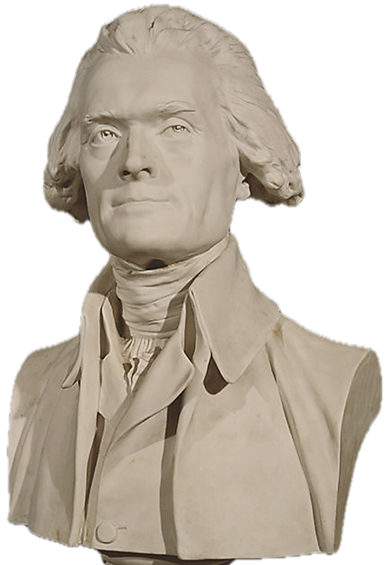
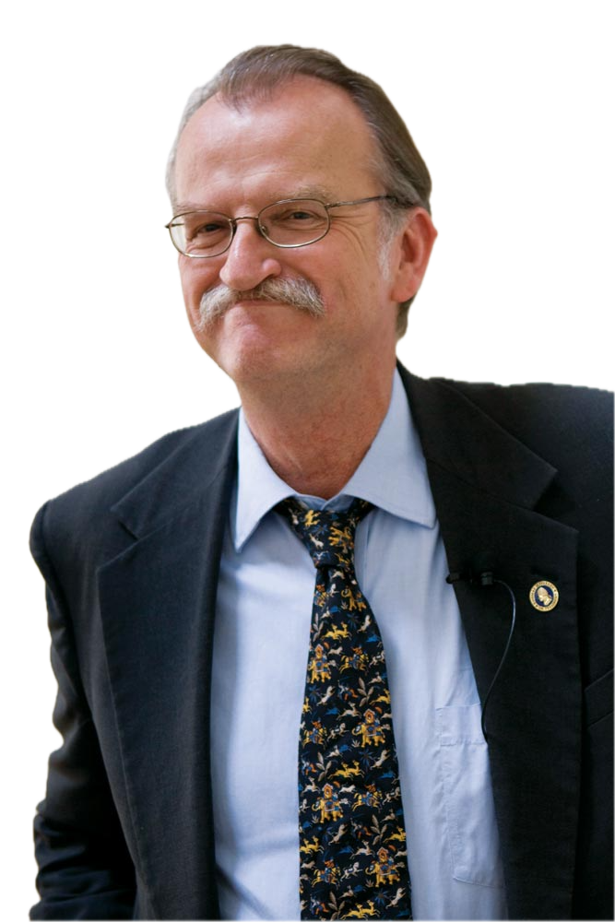
What was I thinking?
The Mind of Thomas Jefferson
Peter S. Onuf

Slide 2
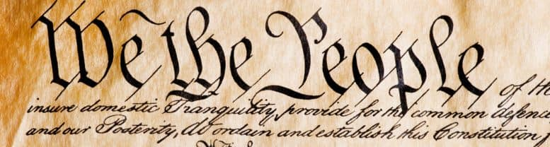
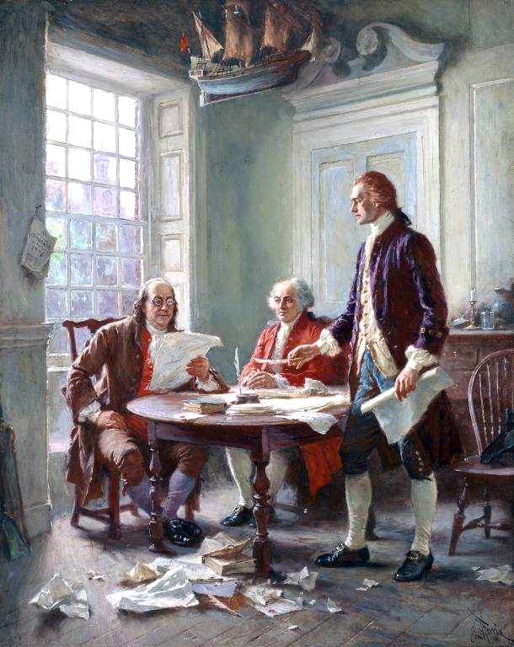
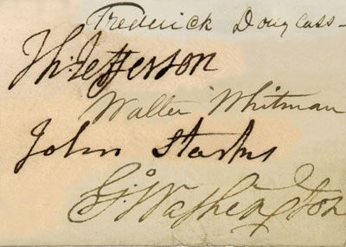
Onuf’s thesis: Penetrating Jefferson’s mind is no mean feat.
“this impenetrability is as much a function of [many historians’] unwillingness to probe as of their subject’s unwillingness to be probed.”
Multiple personas converse and argue with and persuade each other.
Franklin, Adams & Jefferson

Slide 3
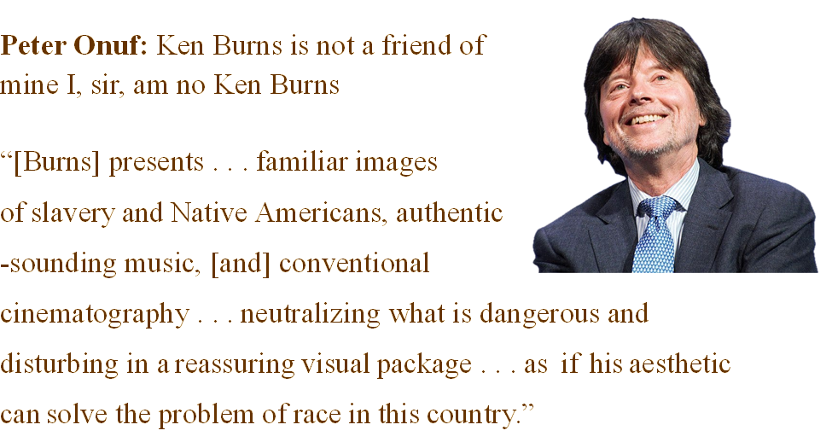
“[W]e live in a radically diﬀerent world than Jeﬀerson’s, yet . . . it must remain inextricably linked to ours . . . .The historian’s role is to protect us against facile appropriations of the past to serve present purposes.”

Slide 4
The most salient subjects in this neatly structured book are
the Declaration, race, slavery, religious freedom and education.
The Declaration was the Big Bang, “the opening salvo of a great struggle to liberate humanity from the tyrannies of the past.”
Jefferson invented America.
He proclaimed the vision of a self-governing people
Inviolate rights granted not by a fickle monarch, but inherent in “The Laws of Nature and of Nature’s God.”
The spiritual copyright on this eloquent, pragmatic, succinct document will never expire.

Slide 5
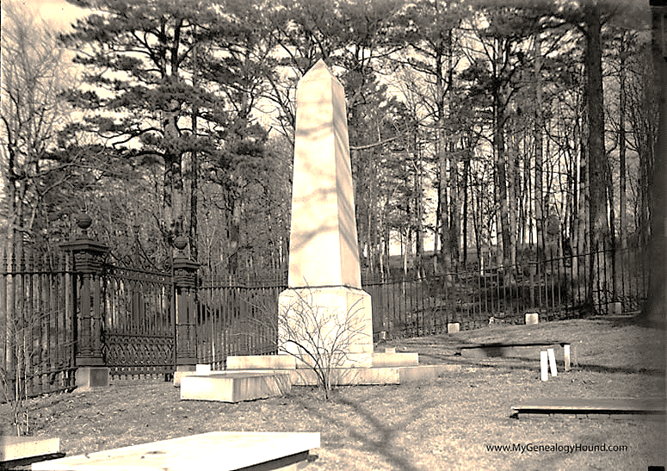
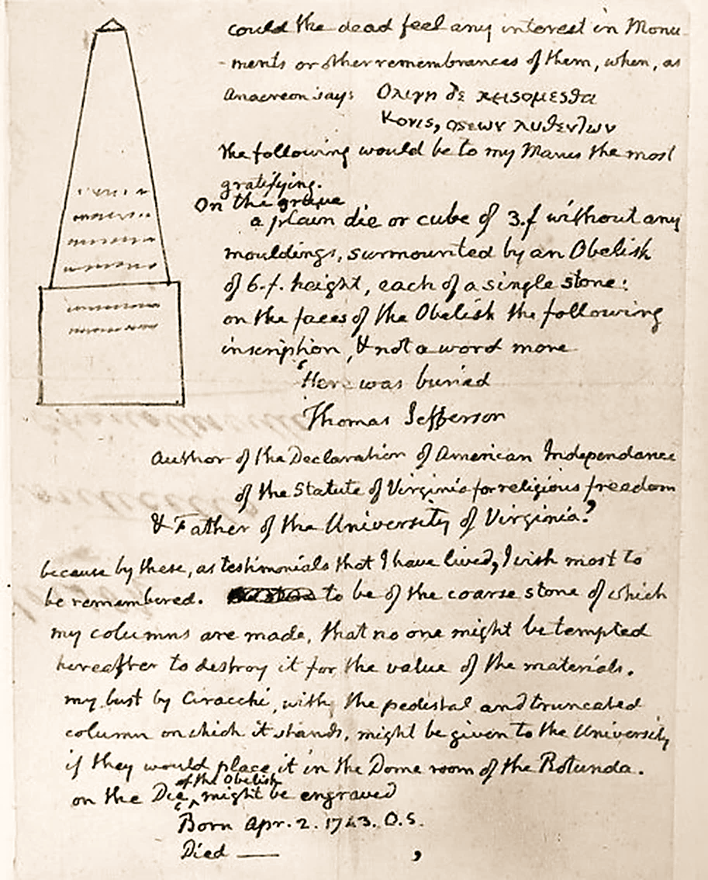
The clean lines of this unadorned obelisk project his ideal of the free, earthbound yeoman farmer.
Here was buried
Thomas Jefferson
Author of the Declaration of American Independence
of the Statute of Virginia for Religious Freedom
& Father of the University of Virginia

Slide 6
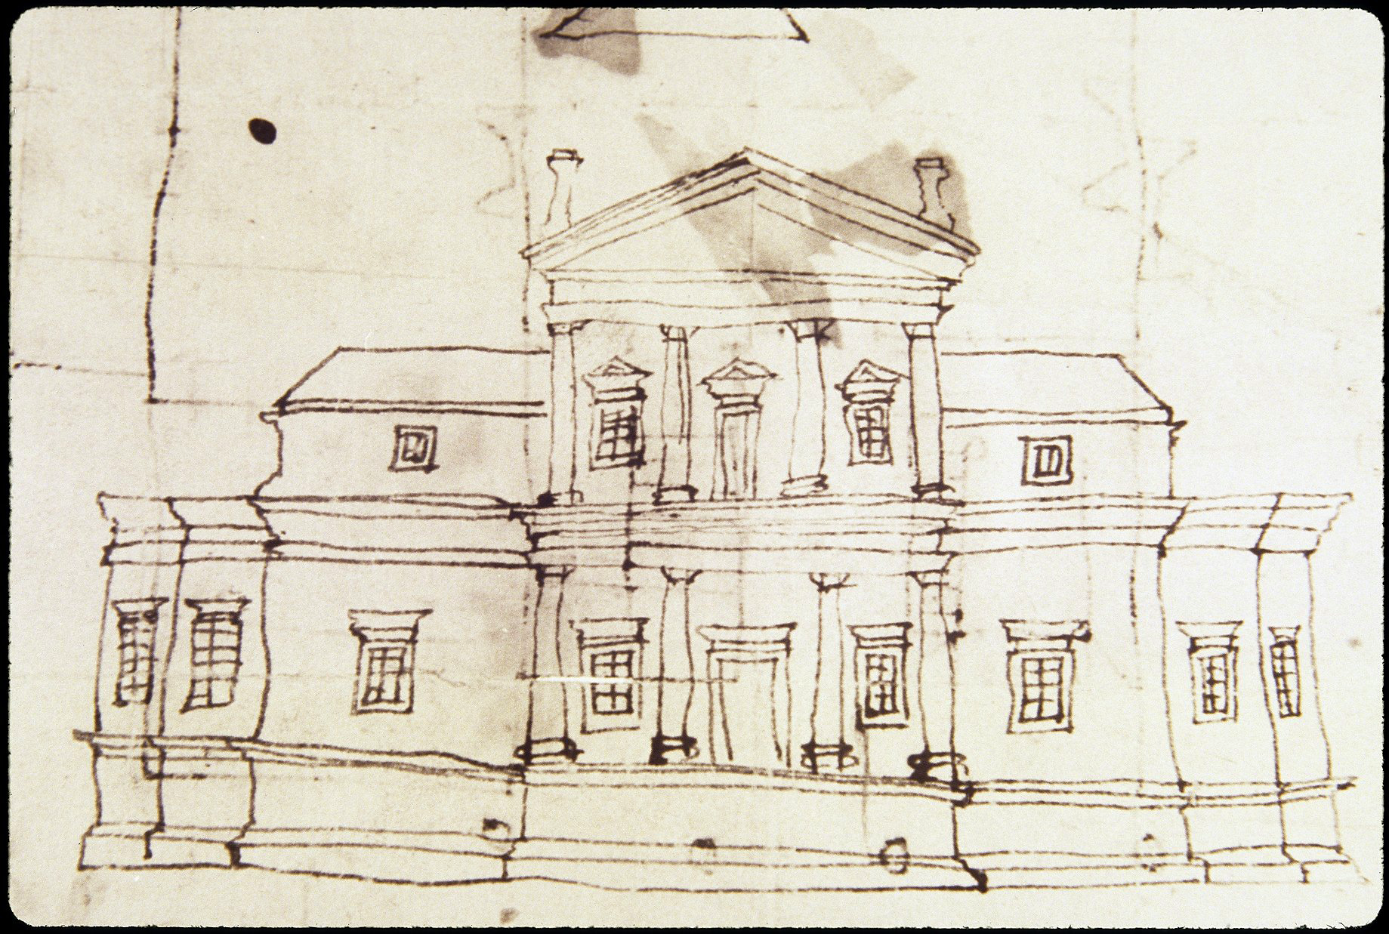
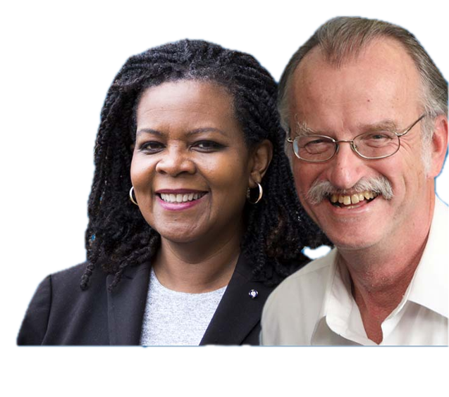
The Road to Monticello
Jefferson’s sketch of the First Monticello
History does not draw straight lines
It is an unwieldy and simultaneously centripetal and centrifugal.
Annette Gordon-Reed and Peter Onuf can handle centripetal and centrifugal.
AGR/PSO World Tour

Slide 7
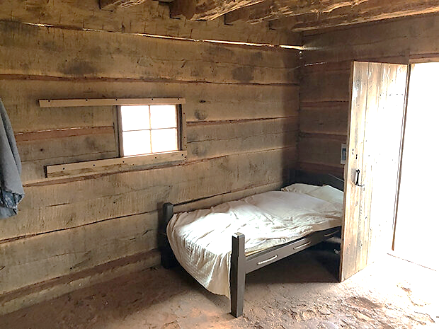
A replica of Sally Hemmings’ cabin
Cognitive dissonance
I suspect that Jeﬀerson was not gripped by guilt over slavery . . . [He was not] . . . inescapably tormented by his . . . failure to [act] . . . against it. [He was ]evidently satisﬁed with the self he so arduously fashioned, not a guilt-ridden schizophrenic . . Jeﬀerson’s moral sense worked . . . not to . . . reconcile or suppress . . . . what we . . . see as fundamental, irreconcilable personal conﬂicts but rather to underwrite an abiding self-assurance that verged on self-righteousness.”

Slide 8

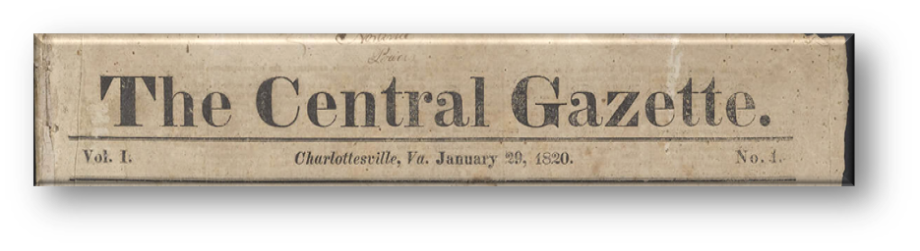
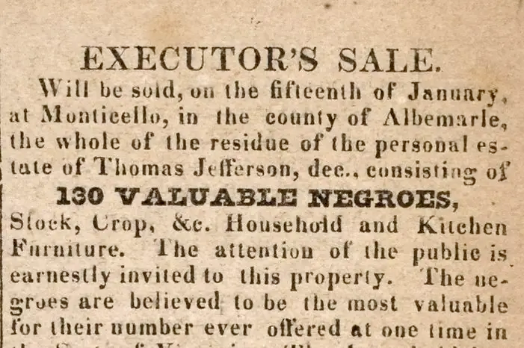
Charlottesville Central Gazette January 15, 1827

Slide 9
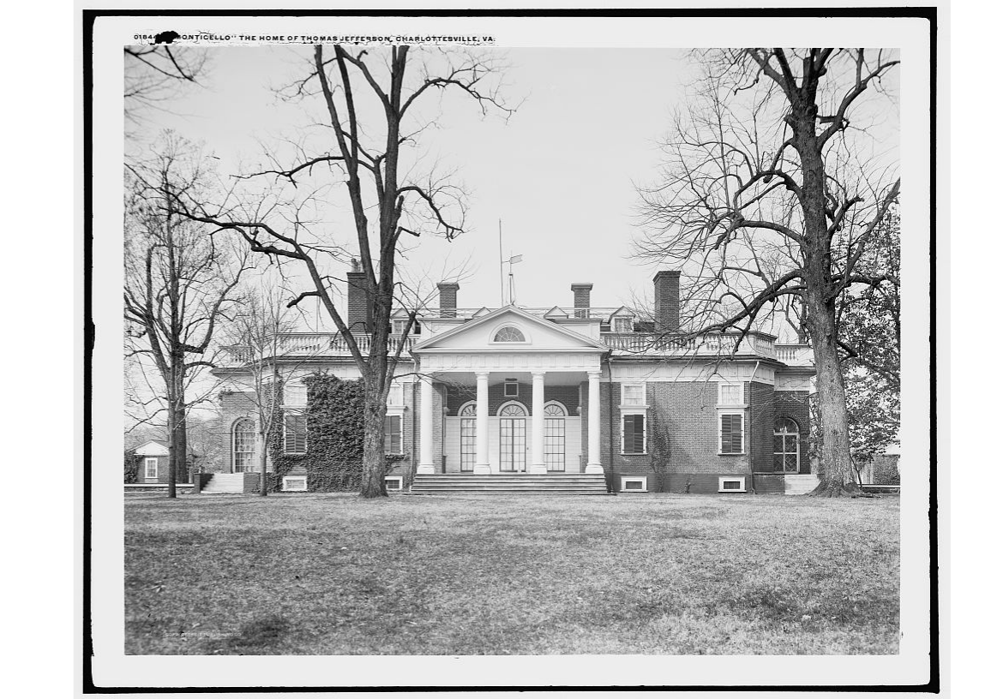
Monticello Estate Auction
Potential buyers included Thomas Jefferson’s family and friends, professors from the recently opened University of Virginia, a man formerly enslaved at Monticello, and the free relatives of enslaved persons about to be sold.
In total, nearly 100 people were sold in bidding that took place over five days.

Slide 10
