Slide 1

A video coding and data visualization tool
Dr. Sarah Berger and Jennifer Ducz
February 25th, 2014

Slide 2
Datavyu – A quick history
MacSHAPA → OpenSHAPA → Datavyu
Databrary project
“developed by and for behavioral scientists”
Notes:
databrary = A web-based repository for data management, collaboration, open sharing, & preservation of videos & assoc metadata

Slide 3
Advantages of Datavyu for Video Coding
extremely flexible, customizable
open platform
  Mac, PC, Linux
Open source
  anyone can have access to code
  designed for plug-ins & additions (soon)

Slide 4
Getting Started
How to download Datavyu 1.0.4:
http://datavyu.org/download_pre/
  If you go to the download site on its own, it’ll ask
  you to download version 1.0.3. Do not do this.
Number keypad w/ laptops
Numpad on desktop keyboards

Slide 5
Spreadsheet
Start with blank page!
as many columns & cells as you want, designed as you want
  Best Practice Tip: use matrix variables & nominal arguments
Best Practice: code down columns
Best Practice: if you see it & you care about it, code it
Notes:
u can use spreadsheet in conjunction w/ data viewer controller to move thru the data stream (e.g., video)
1st thing we said was how flexible datavyu is…

Slide 6
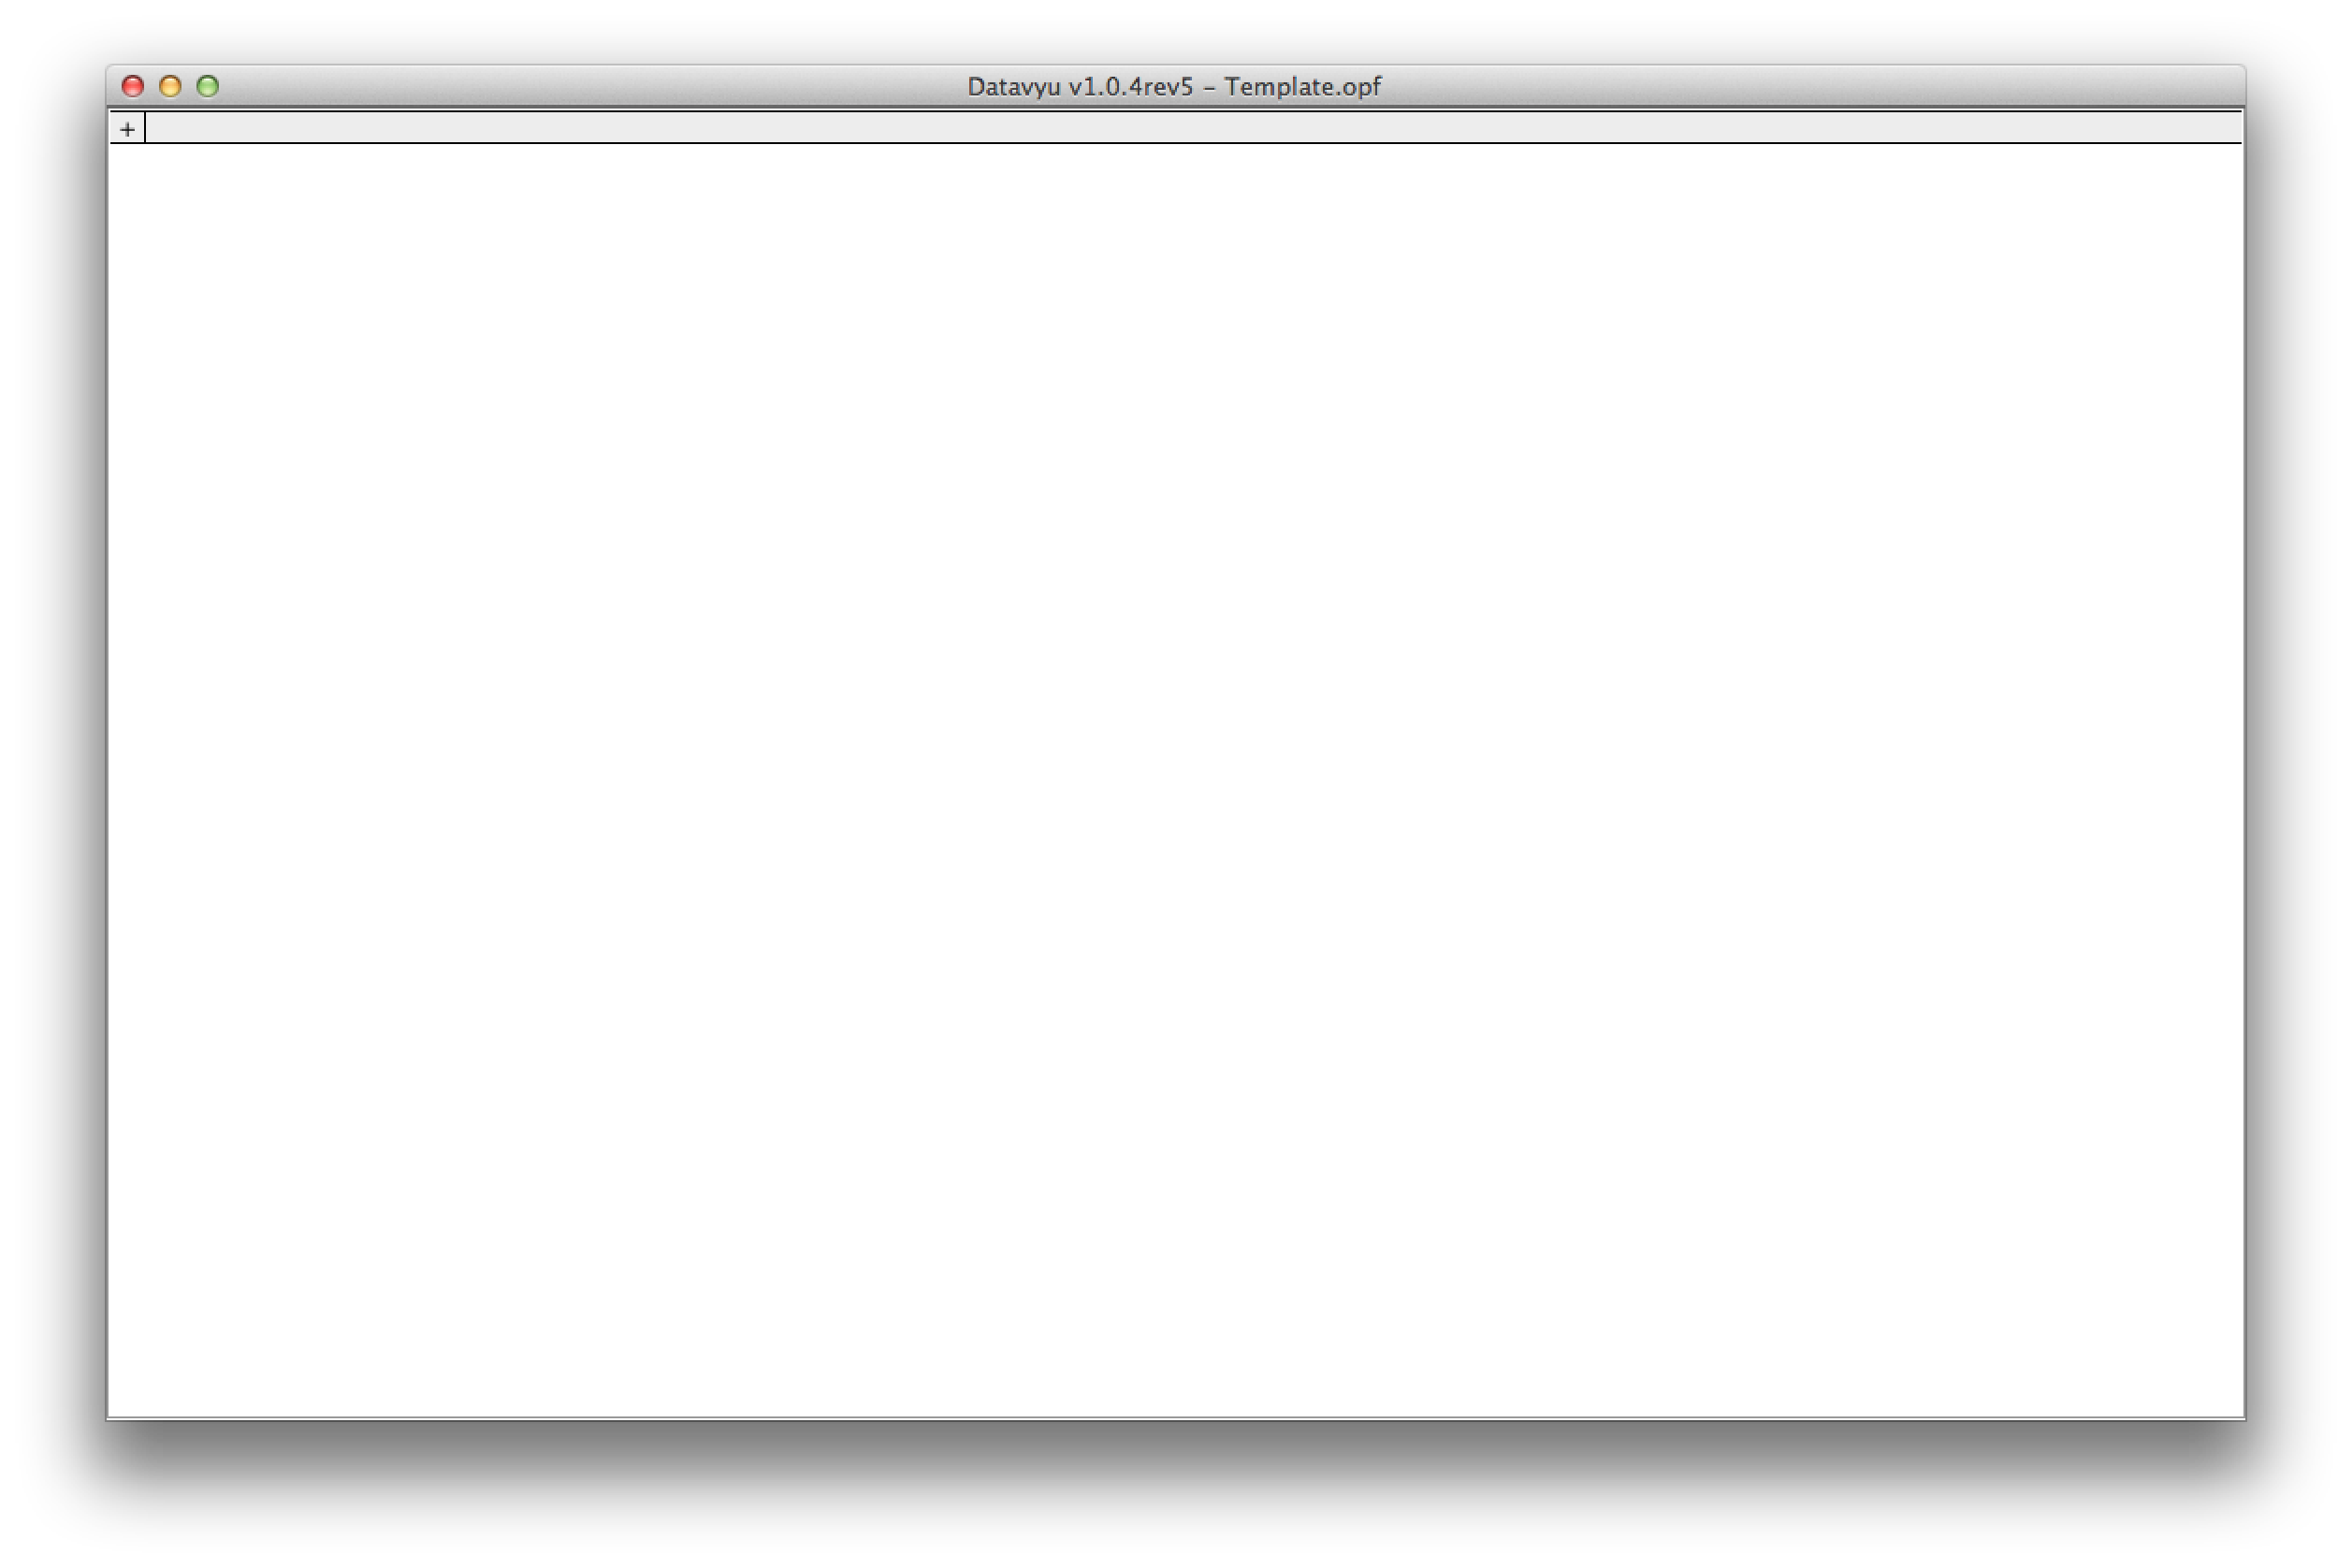
Setting up Spreadsheet

Slide 7
Add Columns & Category Codes
Best Practice: use nested structure of your data to determine the variables
Best Practice: plan spreadsheet based on how you want your data arranged (in excel, SPSS, etc.)
Best Practice: create “comments” variable
Notes:
DEMO ID COND TRIAL

Slide 8
How to make a new column

Slide 9
Adding codes to matrix variables

Slide 10
Code Editor

Slide 11
Coding Manual
Best Practice: specify your coding passes & the category/duration codes for each pass
Advantages to a coding manual
  written record of operational definitions
  easy to train new reliability coders
Notes:
1st thing we said was how flexible datavyu is…
[demo word file you can use ours as starting place]

Slide 12
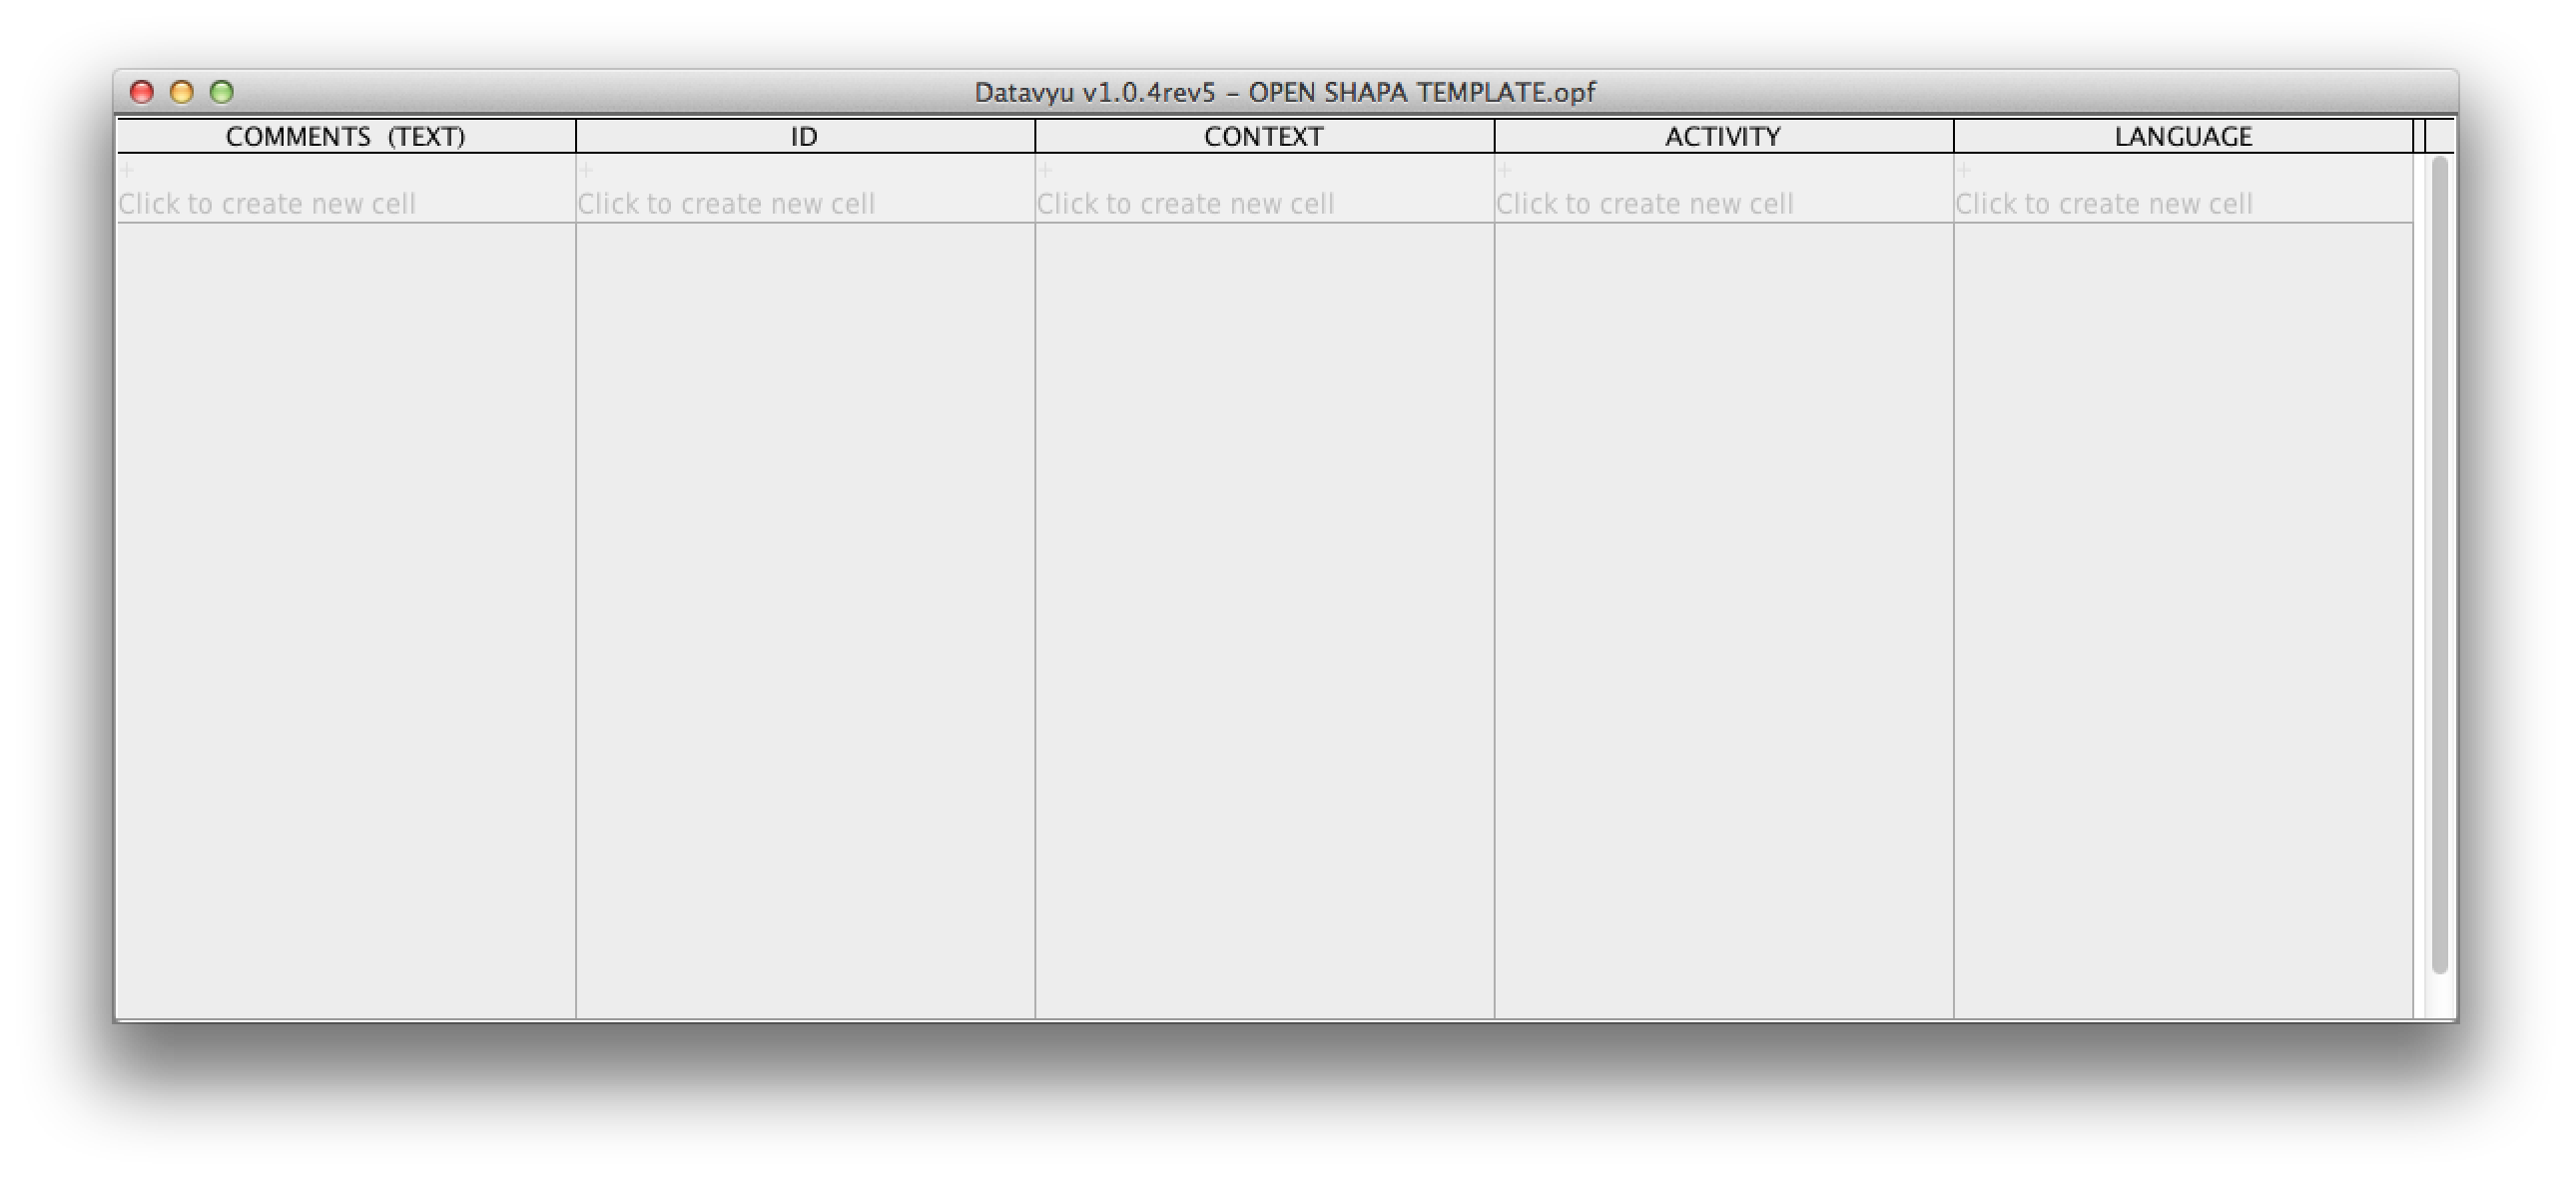
Sample Template
create a template for each study
no need to reinvent with each participant/video
Notes:
Create a template for each study.
No need to re-invent with each participant/video.

Slide 13
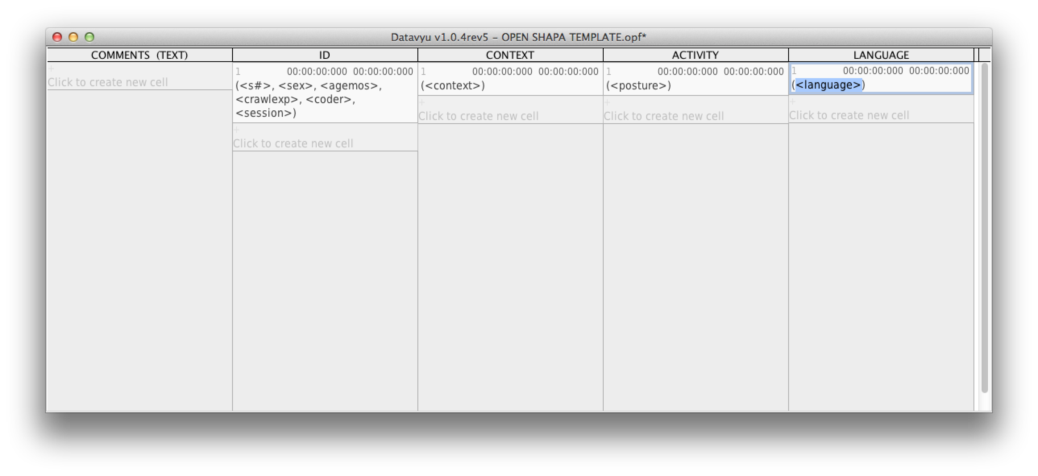
Sample Template w/ blank cells

Slide 14
Adding your videos
spreadsheet is linked to controller

Slide 15
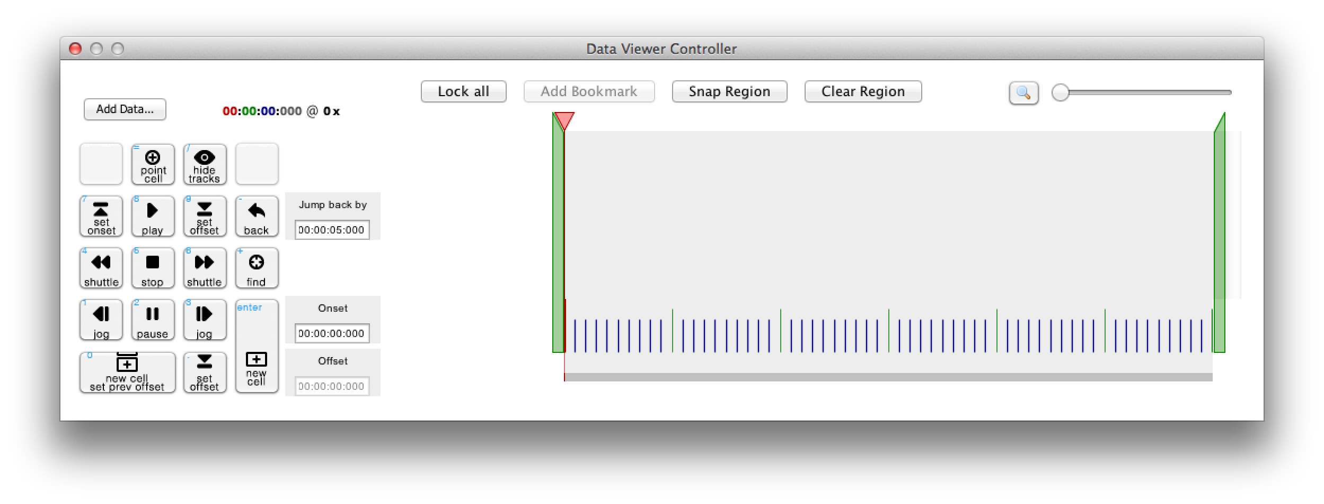
Data Viewer Controller

Slide 16
Data Viewer Controller – The Basics
Notes:
Add data adds video files or other inputs

Slide 17
Data Viewer Controller – The Basics
Notes:
Number keypad
dedicated to data viewer controller
that means can’t use #s on keypad to input #s into spreadsheet
uses quicktime to play video, so any movie format that plays in quicktime will work
Play 1x

Slide 18
Data Viewer Controller – The Basics
Notes:
~ VCR
±32 ±16 ±8 ±4x
±2 ±1x
±1/2 ±1/4 ±1/8
±1/16 ±1/32
Stop = resets speed

Slide 19
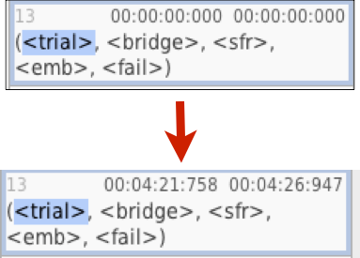
Data Viewer Controller – The Basics
Notes:
set cell onset or offset
to existing cells
changes existing cells w/o adding cells

Slide 20
Data Viewer Controller – The Basics
shortcut!
Notes:
Find onsets & offsets
time windows
shift + find = offset

Slide 21
Spreadsheet: Temporal Ordering
Notes:
shows you structure in the data

Slide 22
Spreadsheet: Temporal Ordering
Notes:
shows you structure in the data

Slide 23
Spreadsheet & Controller:
Onset & Offset Times

Slide 24
Spreadsheet & Controller:
Onset Times

Slide 25
Spreadsheet & Controller:
Offset Times

Slide 26
Scripts
extremely powerful tool – automated ways to interact w/ data
can make changes to single file, all files in dataset, anything in between
  insert cells (reliability, subsequent passes)
  modify cells (adding codes, change codes)
  print cells
Notes:
NOTE: we don’t do this in our lab, but are there sample scripts available for rel checks w/in datavyu? check for typos w/in datavyu?
we always export to SPSS, but would be much more efficient if all could happen w/in coding software
Can look into it.

Slide 27
Scripting
Datavyu runs on a Ruby platform.
Coding is not scary!
http://tryruby.org/levels/1/challenges/0
http://datavyu.org/support
Sample scripts:
https://github.com/databrary/Datavyu-Example-Scripts/tree/master/WorkshopExamples

Slide 28
Scripting basics
Use a text edit software you’re comfortable with (most are free)
Windows:
  Notepad (comes with the computer)
  Notepad++ (downloadable)
Mac:
  TextEdit (comes with the computer)
  TextMate (downloadable)

Slide 29
Scripting basics
For datavyu scripts:
  require 'Datavyu_API.rb’
  Save your file as ‘.rb’ (Denotes script as a ruby script)
#thisisnotahashtag
  # represents annotations
  If something comes after a #, the script will not execute it.
  If your variable has a ‘#’ in it, change it.
Separating your values (useful for printing)
  “\t” – tab delineated
  “\,” – comma delineated

Slide 30
Example – Making a Reliability Cell

Slide 31
Example – Printing to export

Slide 32
Output view

Slide 33
Example – Creating new cells with the same onset.

Slide 34
Other examples -- Recoding

Slide 35
Other examples – Deleting cells

Slide 36
Generating Scripts

Slide 37
Help! My script isn’t working!
Check to see if there’s an error in your script
  You forgot a parentheses, or a quotation mark.
  You spelled something wrong.
  You have a non-existent variable
Check to see if something is wrong in your spreadsheet
  Do all your cells have onset times?
  If Columns are linked, do they have the same onset time?
Go to the support forum!
Notes:
troubleshooting

Slide 38
Customizing Datavyu
Now it’s your turn!
Notes:
Now we’ll take a step back and show you how to customize it for yourself.
Blank file.
Identifying datavyu files you want to use.
Less slides after this, more live demo.

