Slide 1
GETTING PUBLISHED IN URBAN LIBRARY JOURNAL
JUNIOR TIDAL
WEB SERVICES & MULTIMEDIA LIBRARIAN
NEW YORK CITY COLLEGE OF TECHNOLOGY
JUNE 22, 2016

Slide 2
FRAMEWORK
OVERVIEW OF URBAN LIBRARY JOURNAL
THE PEER REVIEW PROCESS
PREPARING MANUSCRIPTS

Slide 3
URBAN LIBRARY JOURNAL

Slide 4
URBAN LIBRARY JOURNAL
URBAN LIBRARY JOURNAL (ULJ) IS AN OPEN ACCESS, REFEREED JOURNAL OF RESEARCH THAT ADDRESSES ALL ASPECTS OF URBAN LIBRARIES AND LIBRARIANSHIP.

Slide 5
URBAN LIBRARY JOURNAL
THE JOURNAL WAS FIRST PUBLISHED IN 1972, ORIGINALLY CALLED LACUNY JOURNAL.

Slide 6
URBAN LIBRARY JOURNAL
THE INTENT OF LACUNY JOURNAL WAS TO PUBLISH THE PROCEEDINGS OF THE ANNUAL LACUNY INSTITUTE.

Slide 7
URBAN LIBRARY JOURNAL
IN 1982, IT WAS RENAMED TO URBAN ACADEMIC LIBRARIAN.

Slide 8
URBAN LIBRARY JOURNAL
URBAN ACADEMIC LIBRARIAN WAS RENAMED A THIRD TIME TO URBAN LIBRARY JOURNAL IN 1998.

Slide 9
URBAN LIBRARY JOURNAL
URBAN LIBRARY JOURNAL NAME CHANGE EXPANDED THE SCOPE OF THE PUBLICATION TO INCLUDE ACADEMIC, SCHOOL, PUBLIC AND SPECIAL LIBRARIES.

Slide 10
URBAN LIBRARY JOURNAL
THE EDITORIAL BOARD WAS EXPANDED BEYOND CUNY, AND INCLUDES MANY NATIONALLY RECOGNIZED LIBRARIANS.

Slide 11
URBAN LIBRARY JOURNAL
IN 2007, ULJ MIGRATED FROM A PRINT PUBLICATION TO TO AN ONLINE ONE USING THE FREELY AVAILABLE OPEN JOURNAL SYSTEM.

Slide 12
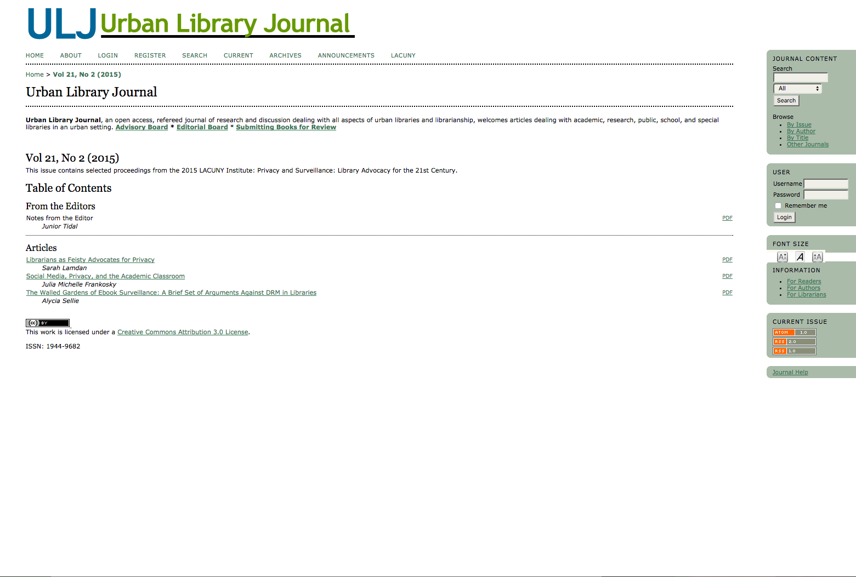

Slide 13
URBAN LIBRARY JOURNAL
THIS PAST YEAR, ULJ MIGRATED TO CUNY’S INSTITUTIONAL REPOSITORY ACADEMIC WORKS WITH A NEW LOOK AND LOGO.

Slide 14
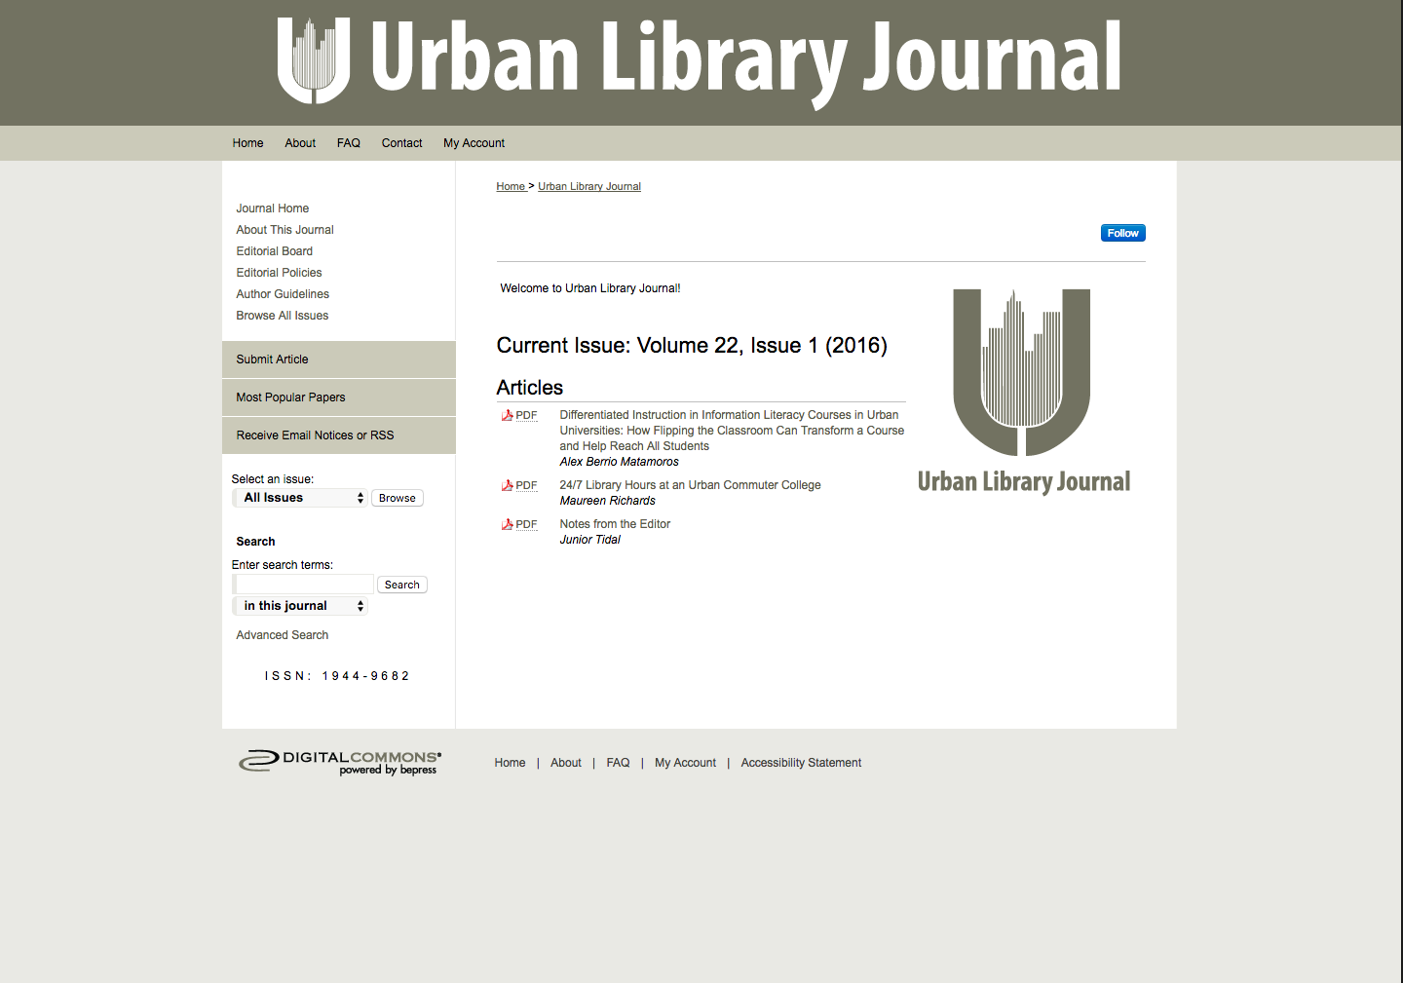

Slide 15
URBAN LIBRARY JOURNAL
ACADEMIC WORKS PROVIDES AUTHORS AND EDITORS STATISTICS ON ARTICLE DOWNLOADS.

Slide 16
URBAN LIBRARY JOURNAL
IT HAS ALSO STREAMLINED THE PEER-REVIEW PROCESS.

Slide 17
PEER REVIEW PROCESS

Slide 18
PEER REVIEW PROCESS
ULJ HAS AN EDITORIAL BOARD AND A COLLECTIVE OF REVIEWERS.

Slide 19
PEER REVIEW PROCESS
ULJ USES A BLIND REVIEW PROCESS.

Slide 20
PEER REVIEW PROCESS
THE EDITOR(S) AND EDITORIAL BOARD SELECTS REVIEWERS.

Slide 21
PEER REVIEW PROCESS
ARTICLES ARE TYPICALLY GIVEN TO REVIEWERS WHO ARE FAMILIAR WITH THE CONTENT.

Slide 22
PEER REVIEW PROCESS
Author submits article
Editors review article
Article is passed to reviewers
Articles are rejected/returned to author if out of scope.

Slide 23
PEER REVIEW PROCESS
Reviewers comment on article
Articles are returned to editors
Editors examine articles and return them to authors

Slide 24
PEER REVIEW PROCESS
Authors modify articles
Editors examine changes to articles
Article is published
Articles may be returned to authors

Slide 25
PREPARING MANUSCRIPTS

Slide 26
PREPARING MANUSCRIPTS
ULJ HAS SPECIFIC GUIDELINES FOR AUTHORS. MANUSCRIPTS ARE ACCEPTED IF THE ARTICLE FITS WITHIN THE SCOPE OF ULJ.

Slide 27
PREPARING MANUSCRIPTS
MANY ARTICLES HAVE BEEN REJECTED BECAUSE THEY DON’T FOLLOW THE THEME OF URBAN LIBRARIANSHIP.

Slide 28
PREPARING MANUSCRIPTS
LOOK AT BACK ISSUES TO SEE IF YOUR ARTICLE FOLLOWS SIMILAR THEMES.

Slide 29
PREPARING MANUSCRIPTS
HAVE A COLLEAGUE READ OVER YOUR ARTICLE PRIOR TO SUBMISSION.
Notes:
Specific guidelines can be found here: http://academicworks.cuny.edu/ulj/author_guidelines.html

Slide 30
PREPARING MANUSCRIPTS
ULJ HAS SPECIFIC GUIDELINES FOR AUTHORS WHEN PREPARING MANUSCRIPTS.
Notes:
Specific guidelines can be found here: http://academicworks.cuny.edu/ulj/author_guidelines.html

Slide 31
PREPARING MANUSCRIPTS
SOME ARTICLES HAVE BEEN RETURNED DURING THE DRAFTING PROCESS IF THESE GUIDELINES AREN’T FOLLOWED.
Notes:
Specific guidelines can be found here: http://academicworks.cuny.edu/ulj/author_guidelines.html

Slide 32
PREPARING MANUSCRIPTS
UNDERSTAND HOW TO SUBMIT OR WHO TO SUBMIT ARTICLES TO.

Slide 33
TIPS FOR SUBMITTING TO ULJ

Slide 34
TIPS FOR SUBMITTING TO ULJ
COMMUNICATE WITH THE EDITOR(S) FOR GUIDANCE.

Slide 35
TIPS FOR SUBMITTING TO ULJ
TRY TO MEET DEADLINES.
DEADLINES IMPACT NOT ONLY YOUR WORK, BUT OTHERS WHO HAVE CONTRIBUTED TO THE JOURNAL.

Slide 36
TIPS FOR SUBMITTING TO ULJ
REVISE ARTICLES WITH REVIEWER SUGGESTIONS

Slide 37
QUESTIONS?

Slide 38
THANKS!

